Slide 1

Instructor Guide
PSON Learning Center
Contact:
Kurt Villcheck,
IT Specialist/Simulation Assistant
kurt.villcheck@mountsinai.org

Slide 2
Index
1. What is Moodle? ……………………………………………….3
2. User Login, Profile settings…………………….…………....4, 5
4. Entering your course page…….................................................6
5. Viewing Course content……..................................................7,8
6. Adding Course content….....................................................9,10
7. Editing Course content….........................................................11
8. Advanced Course content …...................................................12
9. Moodle Training Course page…..............................................13
10. IT Support Request ….......................................................14, 15
11. PSON Moodle Mobile………..……………...………………..16
12. PSON Webmail…………………………...………..……….,17,18

Slide 3
What is Moodle?
Moodle is an open source learning management system used by many schools and universities worldwide. It allows educators to create a secure personalized learning environment rich in all forms of digital content.

Slide 4
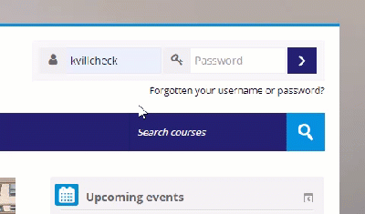
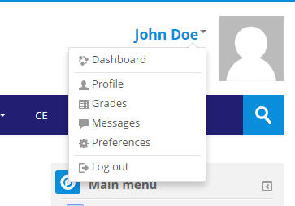
1. User Login
2. Editing Your Profile
When you first go to the main Moodle page, at https://pson.moonami.com/, you will login to your account on the upper right hand corner of the page.
Click on your name, or the triangle to the right of your name to pull up the dropdown menu as shown below. Choose Preferences.

Slide 5
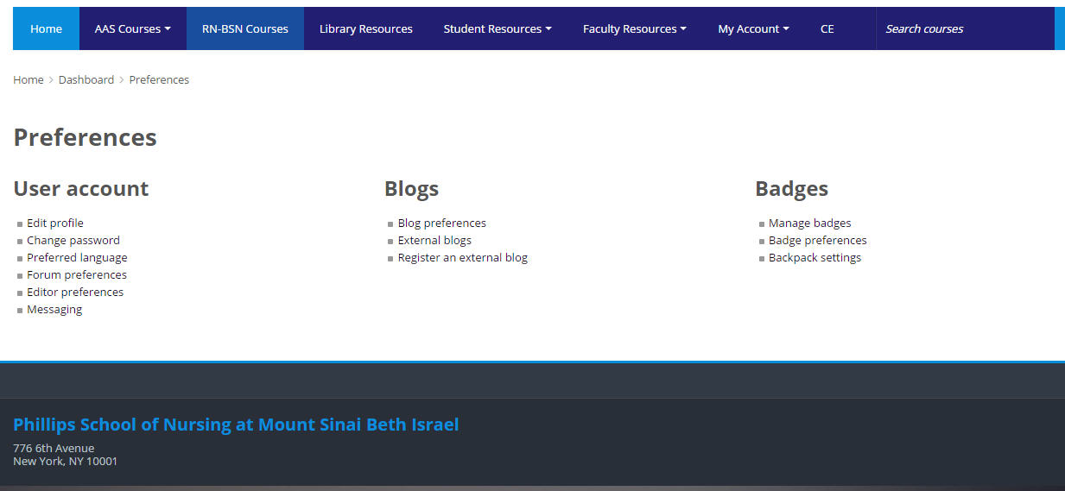
3. Setting Preferences
From your Preferences menu choose Edit Profile to update your information such as your email address, interests, or upload your photo. Choose Change password to update your password.

Slide 6
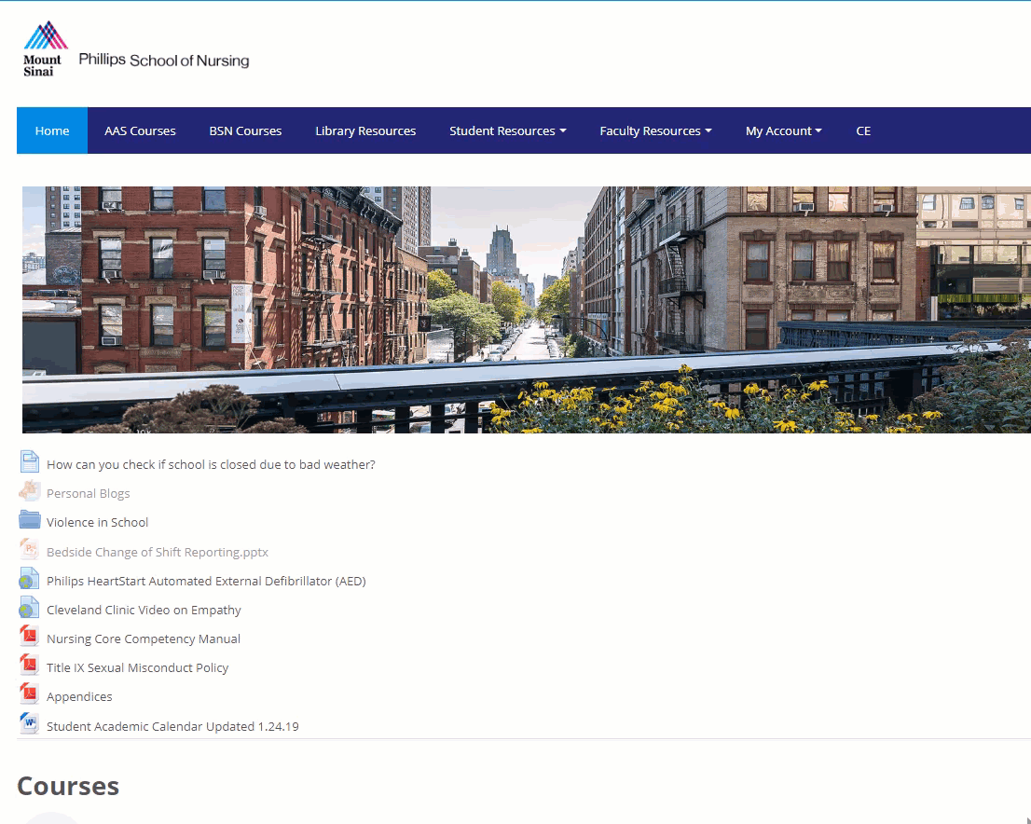
4. Entering your course page
You can enter your course page by clicking on my account and my courses.

Slide 7
5. Viewing Course content
The content on the course pages are in weekly format shown in next slide. The top section is reserved for general course documents, such as learning packets and course outlines.
To open content, click on the file name. You will need to have the application associated with the file to view it. Note: If you do not see the file loading it may be minimized. The icon next to the file shows you what type of file it is.
On the top right you have Latest news which will be news updates from your instructors. The calendar below will display upcoming courses and events. The calendar is not used for every course, so it will depend on if your instructor uses it.

Slide 8
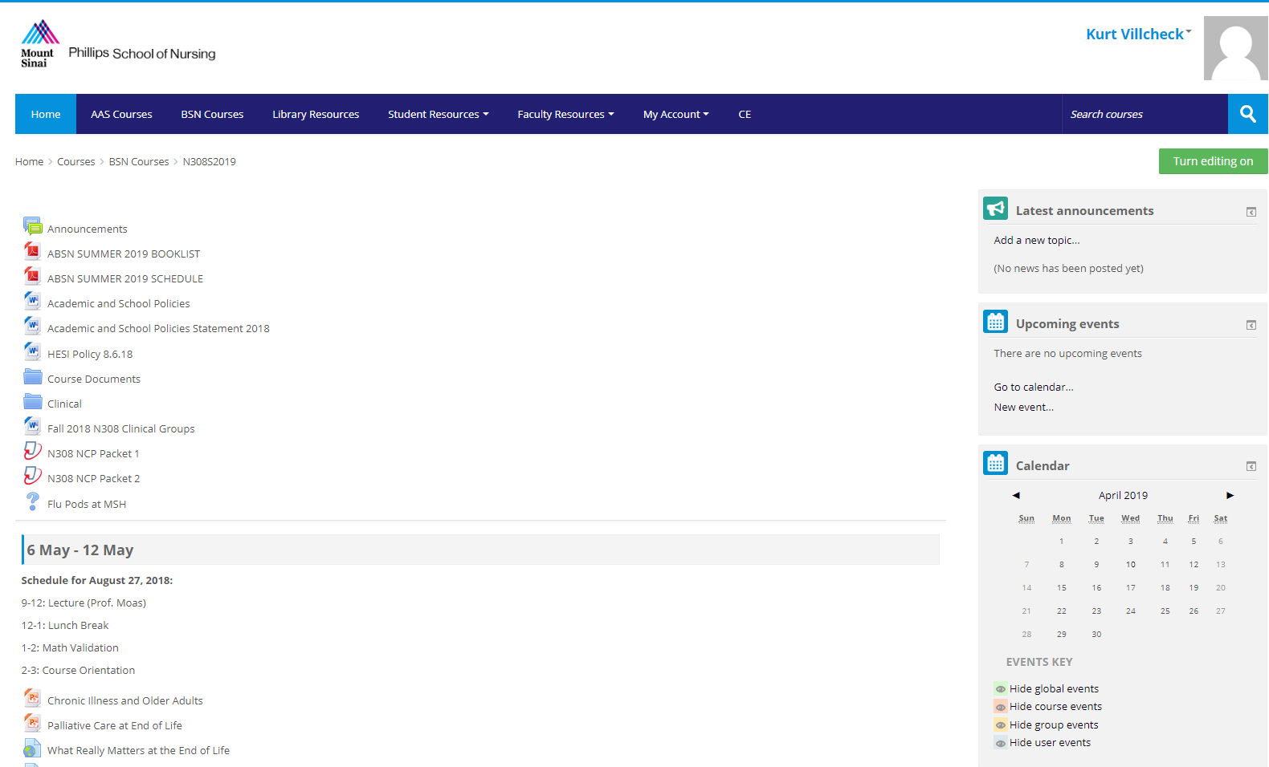

Slide 9
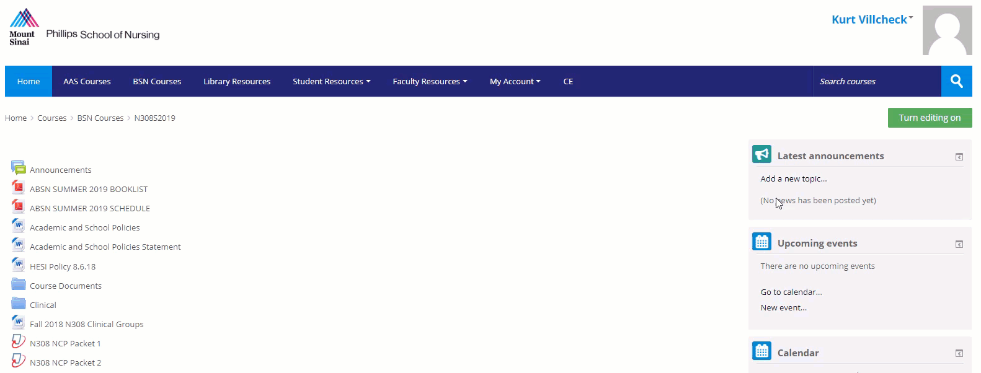
6. Adding Course content
On your course page click on turn editing on you will need to be logged in.

Slide 10
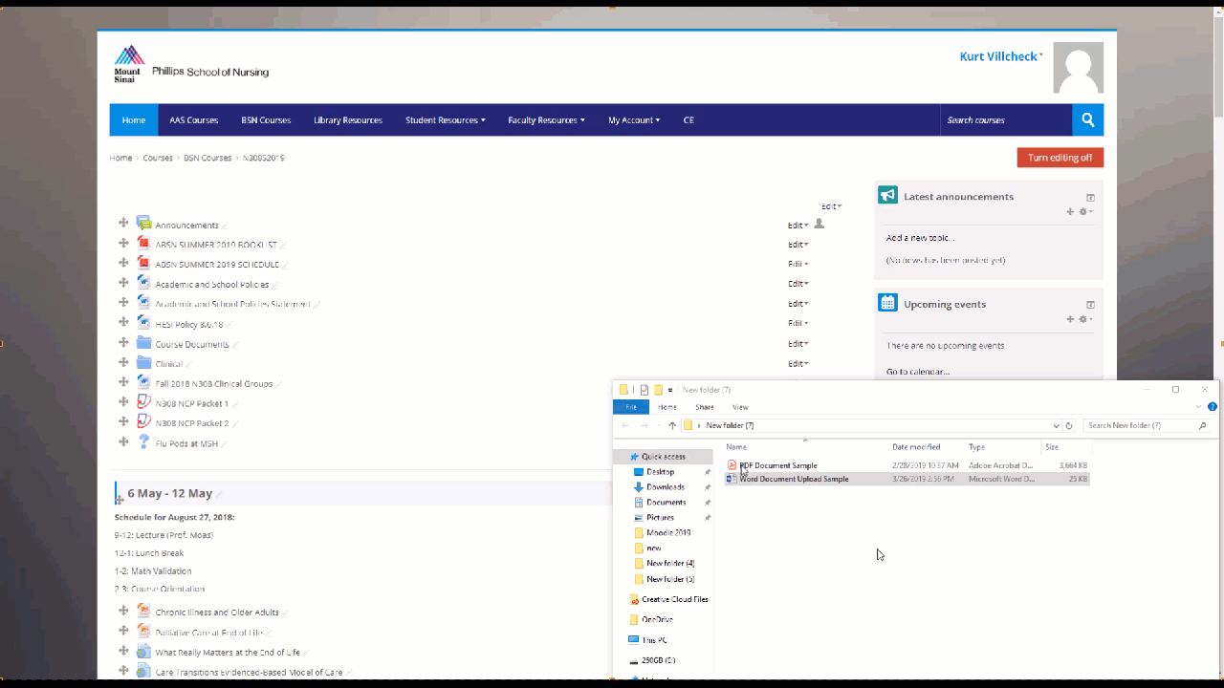
Adding Course content (continued)
2. Open the folder that contains the course document(s) you want to add. Drag the file to the week/section you want (as shown below) you will then see an add file here when you have it dragged to the correct spot.
It works well to have the folder of the file you are adding minimized, so you can easily drag the file onto your Moodle Course page. All file types can be added to Moodle.

Slide 11
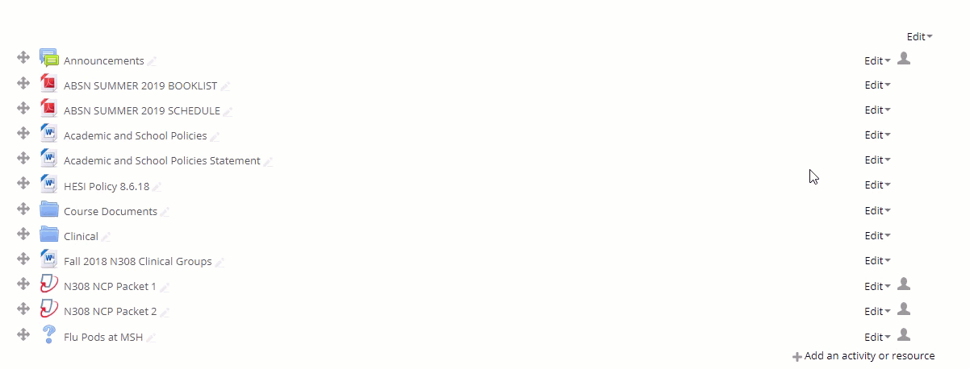
7. Editing Course Content
To edit content click on the editing tab to the right side of the file
Select a editing option from the drop down menu. Hide allows you to hide files from students. The sharing cart allows you to move files from one course page to another.

Slide 12
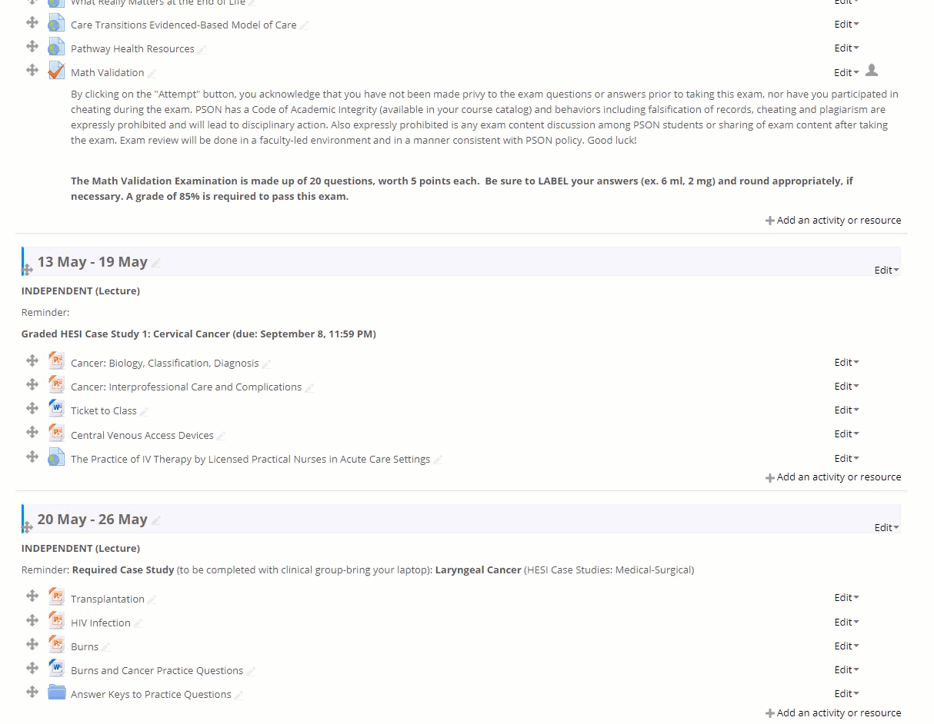
8. Advanced Course Content
Most documents you can drag to your course, but advanced content such as Exams, Discussion boards, Blogs, Chats, & Web links need to be added using Add an activity or resource.
2. Choose the type of content you want to add.

Slide 13
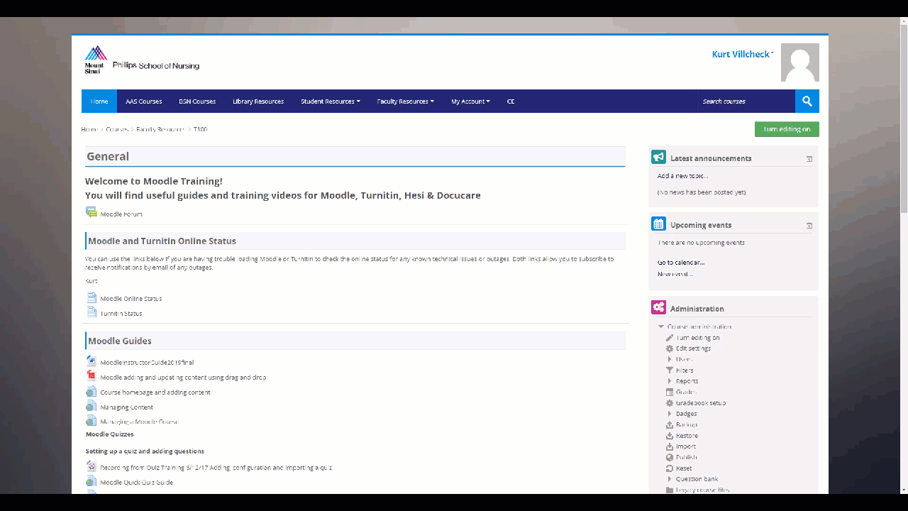
Moodle Training Course Page

Slide 14
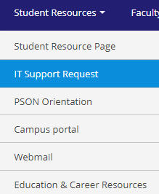
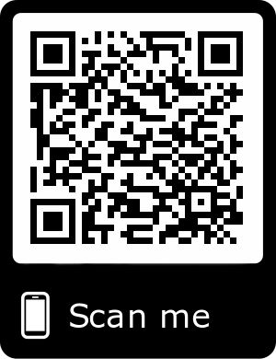
6. IT Support Request
To request PSON IT support from Moodle click on Student Resources/ IT Support Request.
2. You can also submit a Support request anywhere by scanning the QR code with your mobile phones camera.

Slide 15
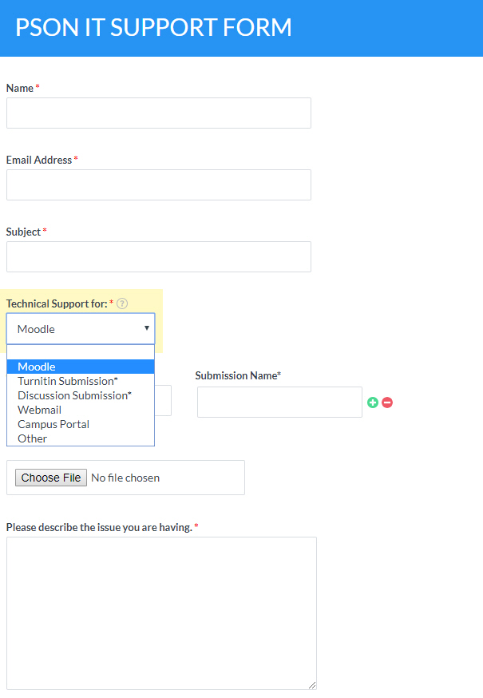
Select a support category from the dropdown menu and complete the support form.

Slide 16
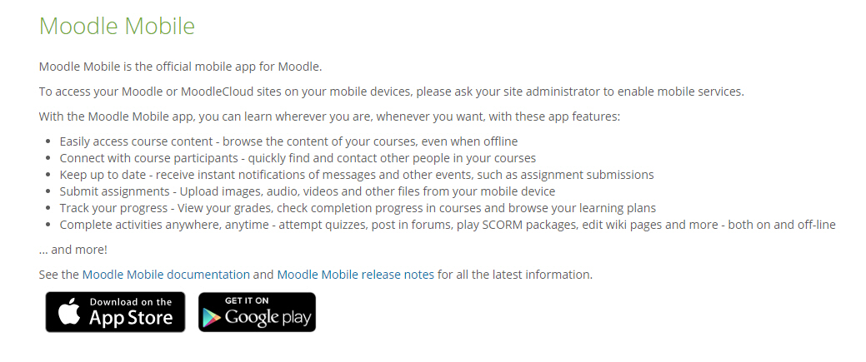
Moodle Mobile
To use Moodle on your mobile phone, you will first need to download Moodle Mobile from here: https://download.moodle.org/mobile/ .You can also find it by searching for Moodle Mobile on ITunes, or the Google Play Store.
When setting up the app it will ask for the url. Type in pson.moonami.com

Slide 17
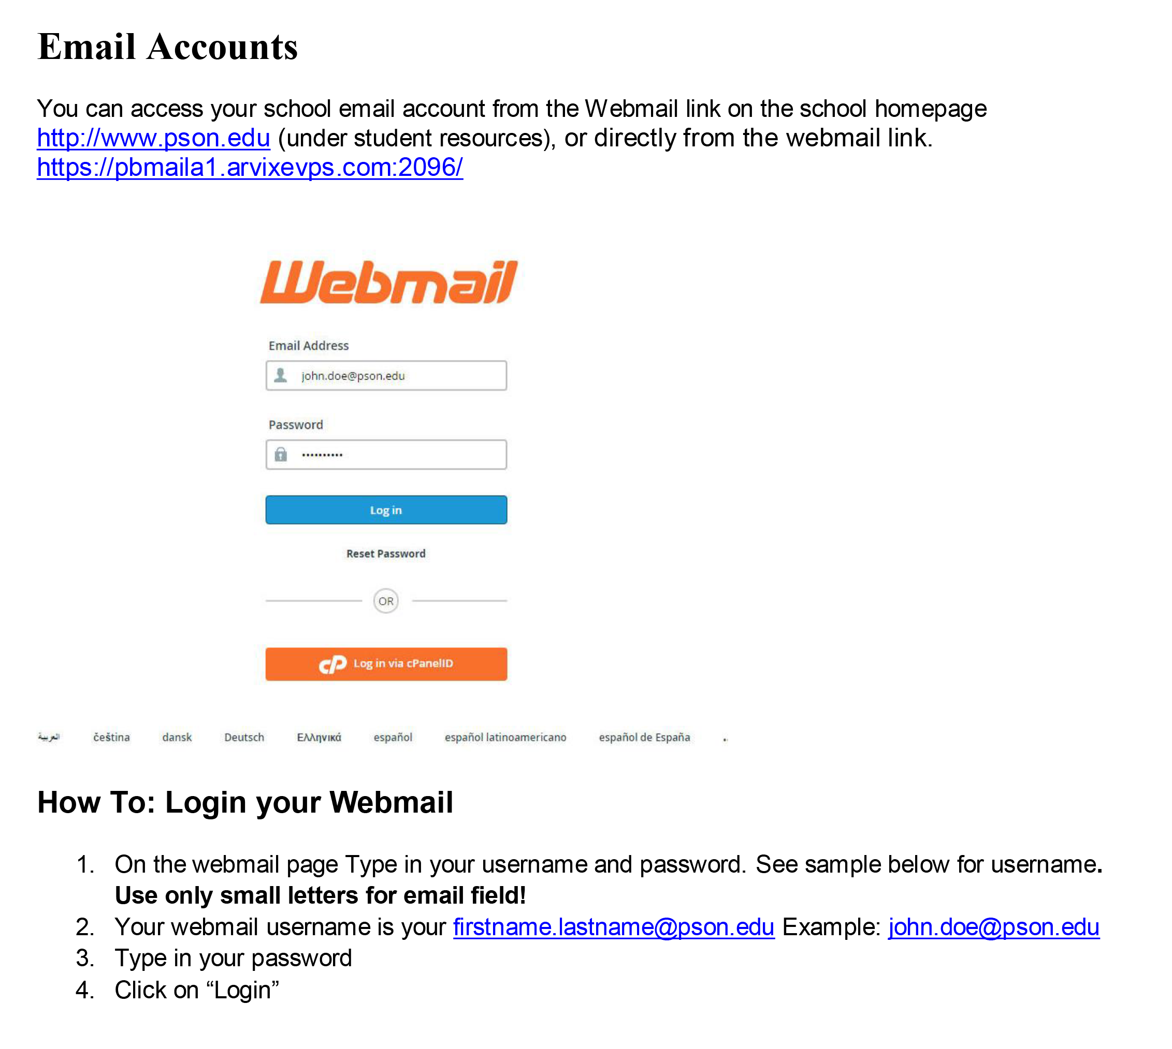
PSON Webmail

Slide 18
