Slide 1
Adding Audio to a PowerPoint and Saving as a Video
Kurt Villcheck
2-22-2014

Slide 2

Adding Sound
1. Load a PowerPoint, or create a new one.
2. Choose the slide that you want to add audio to.
3. From the menu choose insert, and click on audio. If asked, choose audio from file.
4. Locate your audio file, and click insert. (Audio files should be in .mp3 format to reduce file size).

Slide 3

Preview and Play
5. It will create an audio icon ,or box that can be moved anywhere on that slide.
6. Click on slide show from the top menu to preview, or play your clip.

Slide 4
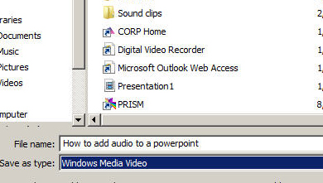
Saving as a Presentation
1. Go to file, and choose save as Windows Media Video. If you are using a Mac save as .Mov.

Slide 5
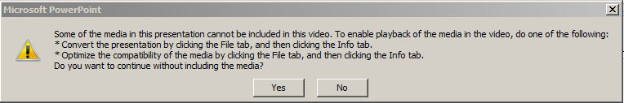
Issues with saving
If you receive the message below when you try to save as a video. You will need to click file, and then click the info tab and choose convert.

