Slide 1


Turnitin examsoft
Your exam portal

Slide 2

What is examsoft?
ExamSoft provides a secure testing environment and allows instructors to easily create, grade, and analyze exams.

Slide 3
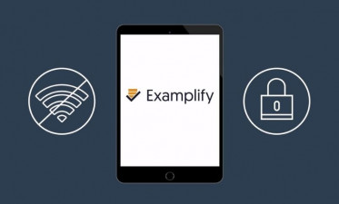
Examplify
While Examsoft is the web portal to see what exams from courses you are subscribed to, Examplify is the desktop app to take the exam.

Slide 4


Main features
Exams are downloadable
Each exam downloaded belongs to the device it was downloaded on
Time freezes if disconnect from the exam or device shuts down
Main features are:
Works offline – internet access only required to download and submit the exam
Ability to lock down the exam taker’s device
Ideal for both in-person and remote learning settings
Class rosters and grades sync with Moodle
advantages

Slide 5


requirements
hardware
software
Processor:
intel i3, i5, i7
AMD Radeon or Ryzen
(There is not support for ARM processors like those M series from Apple MAC computers)
Hard Drive: 256GB and up
Memory RAM: 8GB and up
Screen Resolution: HD and up
Camera and Mic: integrated
Windows computers:
Windows 10 21H2 and 11 22H2 64-bit version
(Windows RT (Mobiles devices) and Windows 10S and 11S not supported)
Apple MAC Computers and IOS:
ISO Big Sur and up
(iPads have no issues since there is an app in the app store)

Slide 6


How to find requirements on your device
Apple
windows
On Apple Mac Computers
Click the Apple icon in the top left corner of your Mac.
Pick the top option: About This Mac.
The resulting window should show you the information you need including processor speed, memory, and graphics card information.
On Windows Computers
Go to the start menu.
Click on Settings -> System
Scroll down to the bottom
Click on "About."
The window should show you the information you need: processor speed, memory, and graphics card information.

Slide 7
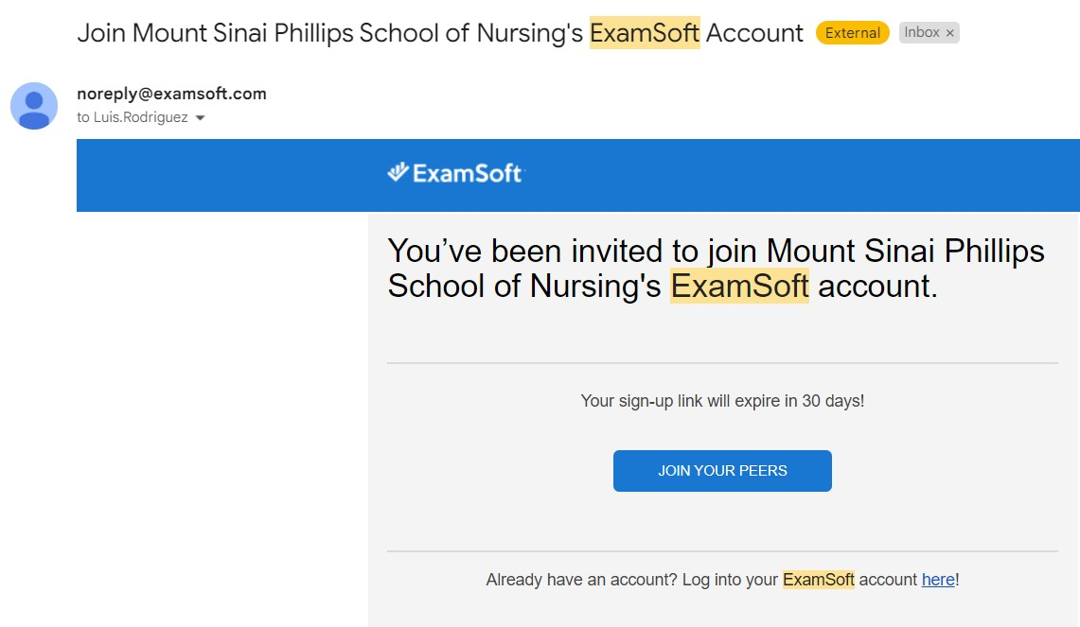
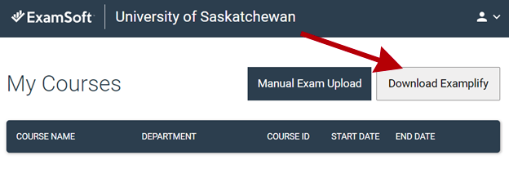
How to join
You can join to Examsoft by invitation only from our department.
You will receive and email from (noreply@examsoft.com) and you will click “Join Your Peers” button. See image here
Once you complete your account, you will download Examplify from the main screen. See image here
Every exam will be available to
download from the Examplify App
once it is posted by your instructor.
iPad: search for "Examplify" on app store.

Slide 8


At time of exam
Raise your hand if you need help during the exams.
Wait for the password to be displayed.
Once you complete the exam, you will need to upload it right away. (You will need to connect to WIFI to submit your exam)
Show your green screen of completion before leaving the exam room. See image
For more information about Examsoft, please see the resource page on Moodle

Slide 9
Thank you!
it@pson.edu
Report any issues or requests at our email

