Slide 1
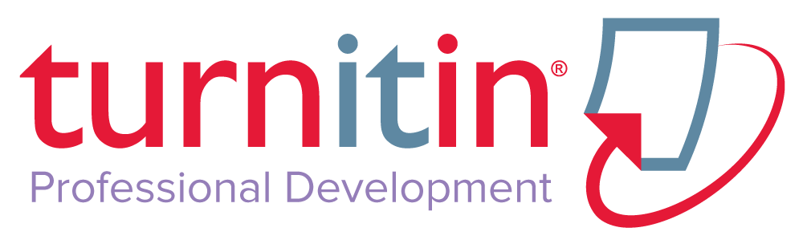

Slide 2

Table of Contents
What is Turnitin?
Guided Walkthrough
Supporting Academic Integrity
Strategies
Plagiarism Spectrum
Student Sources
Additional Resources
Training & Professional Development
Notes:
During today’s session, we’ll be combining the use of a PowerPoint deck for reference and spending time online in Turnitin via a guided tour or “walkthrough.”
Next: What is Turnitin?

Slide 3
What is Turnitin?
What do you know about Turnitin?
What are some common misconceptions about Turnitin?
Training & Professional Development
Notes:
As the leader in “plagiarism prevention,” Turnitin has made a name for itself as the “plagiarism police,” but that’s not actually how the service is intended to work. I’d like to start us off today by talking about some of the misconceptions that attach to Turnitin and to Turnitin use.

Slide 4
Turnitin Misconceptions
Detects plagiarism
Matches are coincidental
Matches identified are the exact source
Training & Professional Development
Notes:
The first—and a big one—is that Turnitin detects plagiarism. Turnitin matches to text in our database and leaves the judgment up to the instructor. Instructors must look at the Originality Reports to determine if there is a problem. Instructors must interpret the paper’s Similarity Index score in the context of the assignment and the actual writing
Next, there may be a sense that matched text is likely completely coincidental or common knowledge. The likelihood that a 16-word match is “just a coincidence” is less than 1 in a trillion. Turnitin also includes the ability to exclude “small matches” if the instructor wants to exclude common phrases.
When we take a look at the Originality Reports, you’ll see the “Similarity Index,” which is a percentage score that shows how much of a submitted paper matches to pre-existing source material. There are a couple of misconceptions around the Similarity Index that I wanted to share with you now. There is the misconception that the “Similarity Index” shows the percentage of a paper that is plagiarized. There is also the mistaken belief that there is some “acceptable” threshold of a Similarity Index such as < 10% or 15%. Don’t worry, we’ll soon see what this looks like on the site. I want you to just keep these misconceptions in mind as we review.
Q: The source named in the Originality Report is the exact source used by the writer
A: There can be many matches because of the amount of duplication on the web. The source named may not be the exact source the student used.
NEXT SLIDE: Originality Check

Slide 5
ORIGINALITY
CHECKING
Notes:
Let’s turn our attention now to Turnitin’s Originality Check. I’m going to start with a few prepared slides, and then we’ll move to Trunk.

Slide 6
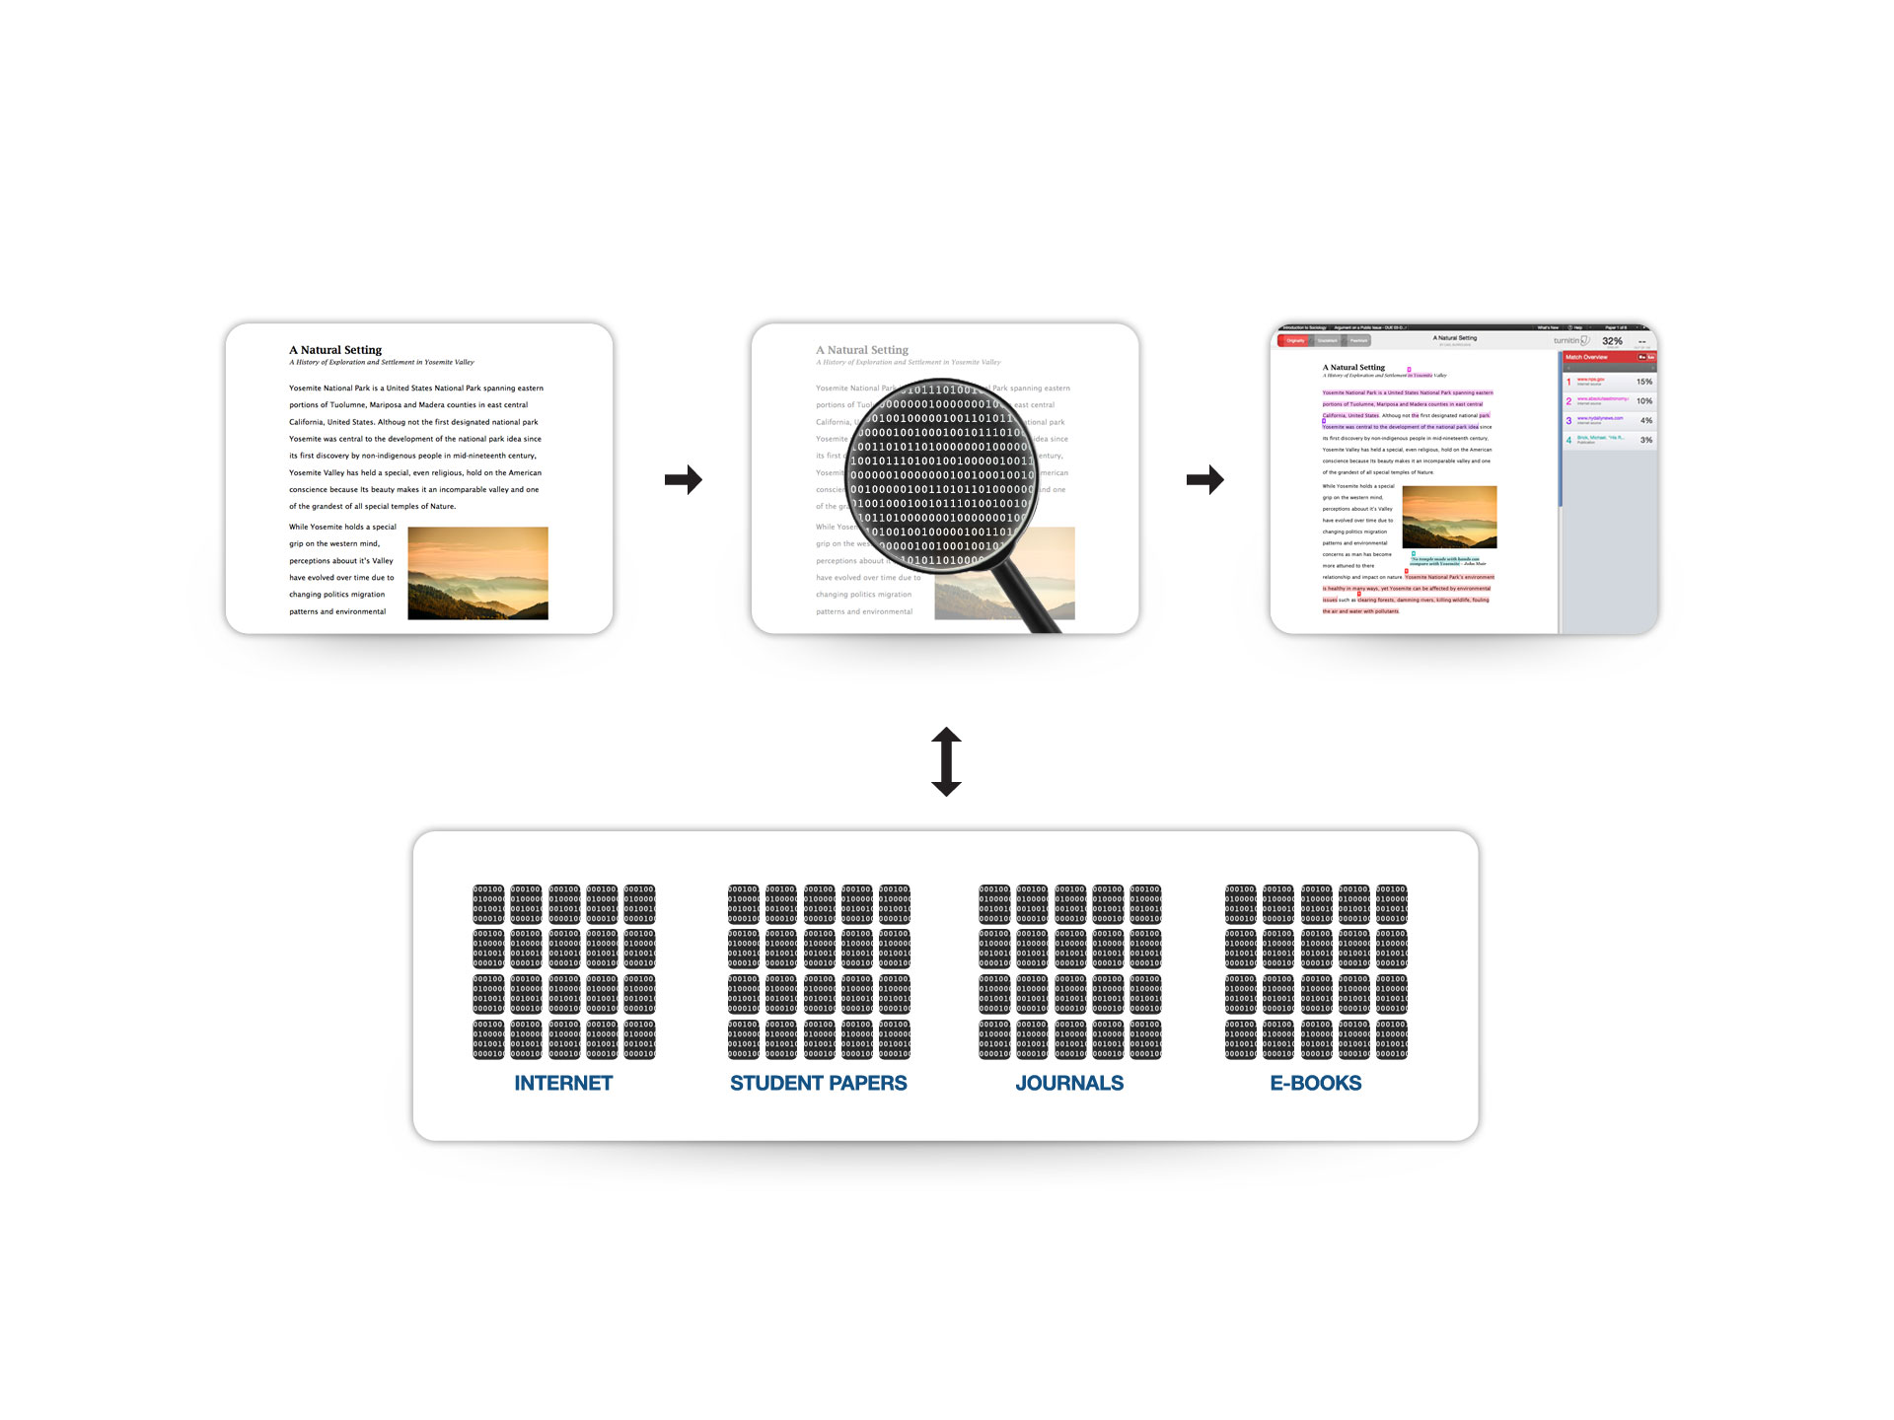
ORIGINALITY CHECKING TECHNOLOGY
Notes:
When a student submits a paper to Turnitin (or a “Turnitin assignment”)_, a proprietary algorithm is used to map the text, creating a “digital fingerprint” of each paper. These fingerprints are then compared against a database of fingerprints comprised of databased internet content, an archive of student papers, subscriptions journals, and e-books. From this comparison an Originality Report is generated. The Report displays the paper’s similarity to the databased content.

Slide 7

How Our Technology works
Technical Challenges
Needle in a Haystack
  For a single paper, check ~100 fragments against:
  A specially indexed copy of the Internet
  400M+ student papers
  130M+ books, journals, magazines and newspapers
Signal vs. Noise
  In parallel, check for fuzzy matches, synonyms, word substitutions, paraphrasing and translated plagiarism
  Deliver close to zero false-positives
Big Data, Fast
  Do this for up to 300,000+ papers a day
  Return results in under a minute
The benefits:
Fast and authoritative: Quick, accurate reports from the world’s largest comparison database
Simple-to-use:
Instructor learning curve is very fast because of our intuitive design
Notes:
For a single paper, Turnitin checks 100 fragments against an indexed copy of the internet, 400M+ student papers, 130M+ books, journals, magazines, and newspapers. In conducting this comparison, one of the key challenges is identifying the “signal” vs. the “noise.” Turnitin has developed algorithms for identifying similarities in ideas or similarities in content even if that content is duplicated with minor word changes. This is what differentiates this type of search versus a text-text match search that appears via a Google search, for example. We also do these comparisons for a large number of papers—up to 300K/day—and quickly.

Slide 8
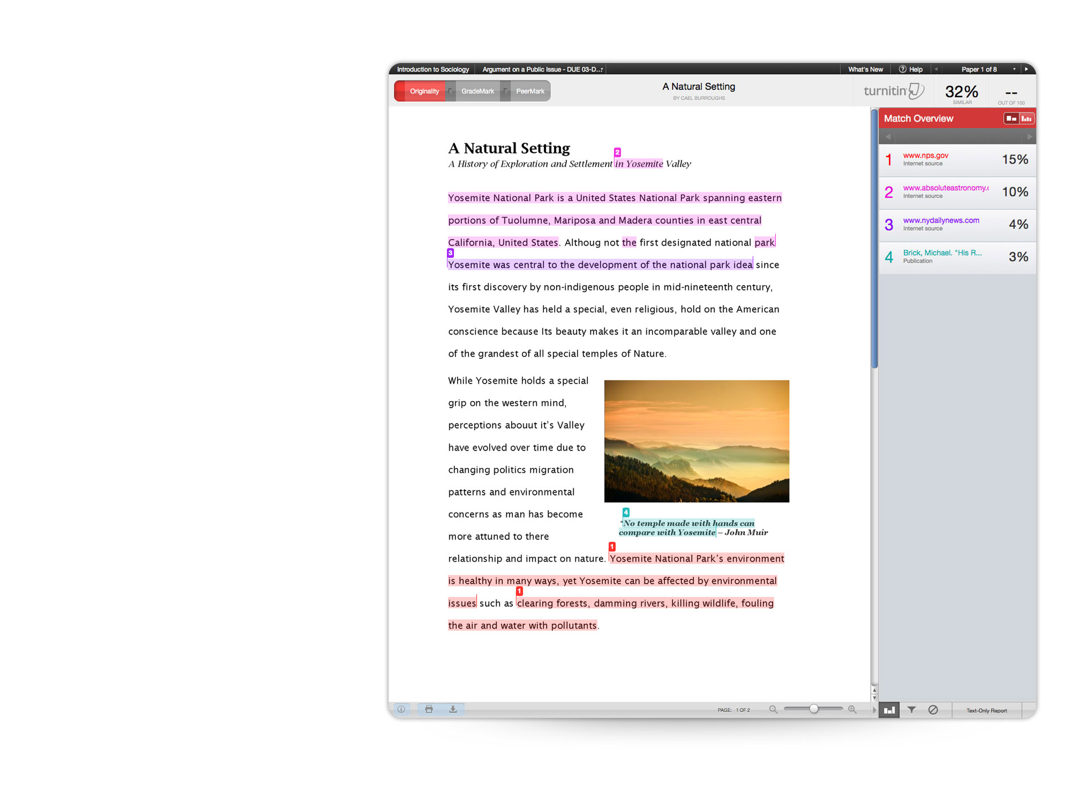
ORIGINALITYCHECK
Identifies matched content by comparing papers against:
35 billion current & archived web pages
300 million student papers
130 million academic articles
Notes:
This is what an Originality Report from OriginalityCheck looks like.
On the left side of the screenshot is the student’s paper… displayed with all of its original formatting, including photos and illustrations. Anything that has matched to something in our database is highlighted in color and matched with a number on the right, which shows the source of the match and gives the link. Sometimes an item will have multiple matches and it will match to multiple sources because there is a lot of duplication on the web, and you can click on each source to see all the additional overlapping sources that the text matches to. The Originality Report includes a similarity index, computed as the percentage of text that matches sources in our database.

Slide 9
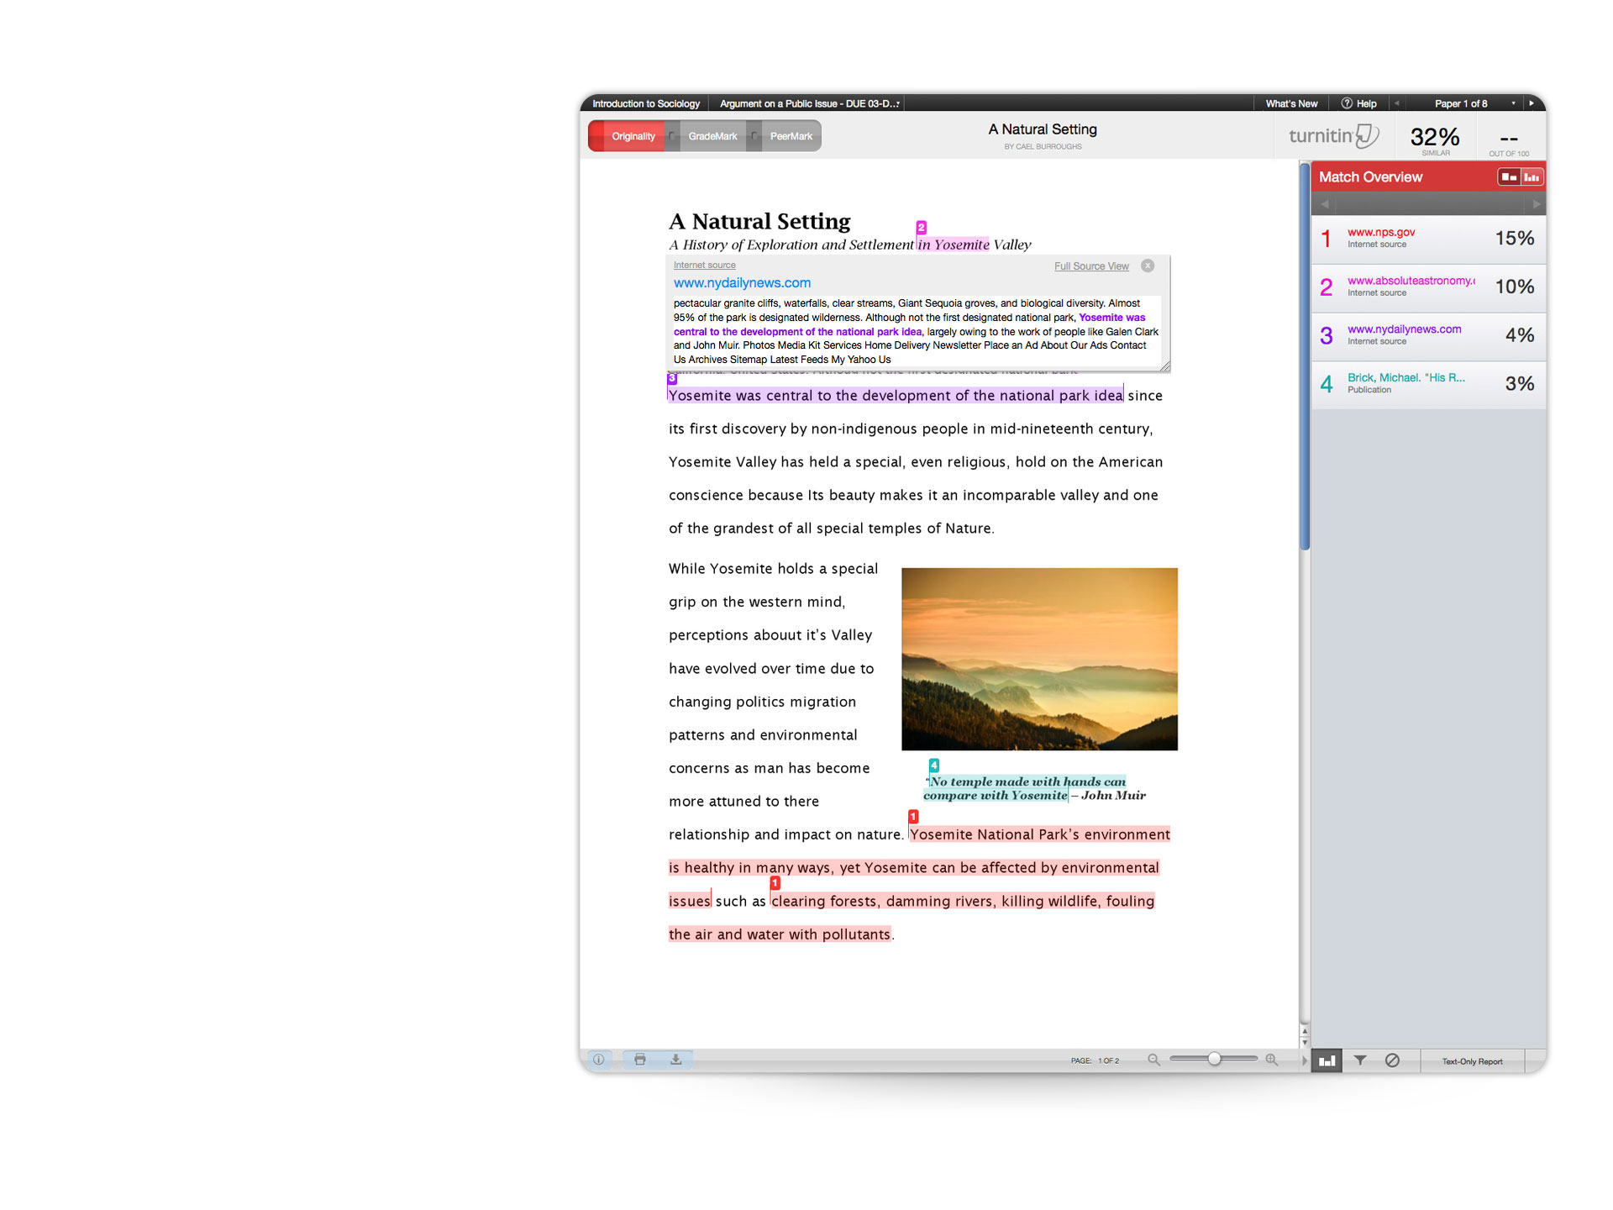
ORIGINALITYCHECK
Insight into students sources
View sources matched in student paper
Compare original source material to student’s written work
Source Preview
View additional sources
Side-by-Side Comparison
Link to Original Source
Exclude quotes and bibliography
Notes:
With OriginalityCheck, instructors can gain insight into students’ sources:
Check student work for similarities to existing source material;
Compare original source material to student work;
Preview a source and view additional sources;
Do a side-by-side comparison;
And, link to the original source.
When OrigialityCheck is used correctly, instructors can ensure that students are aware of and held to the highest standards regarding proper research and citation and support students’ development of academic writing skills.

Slide 10
GRADING
& FEEDBACK

Slide 11
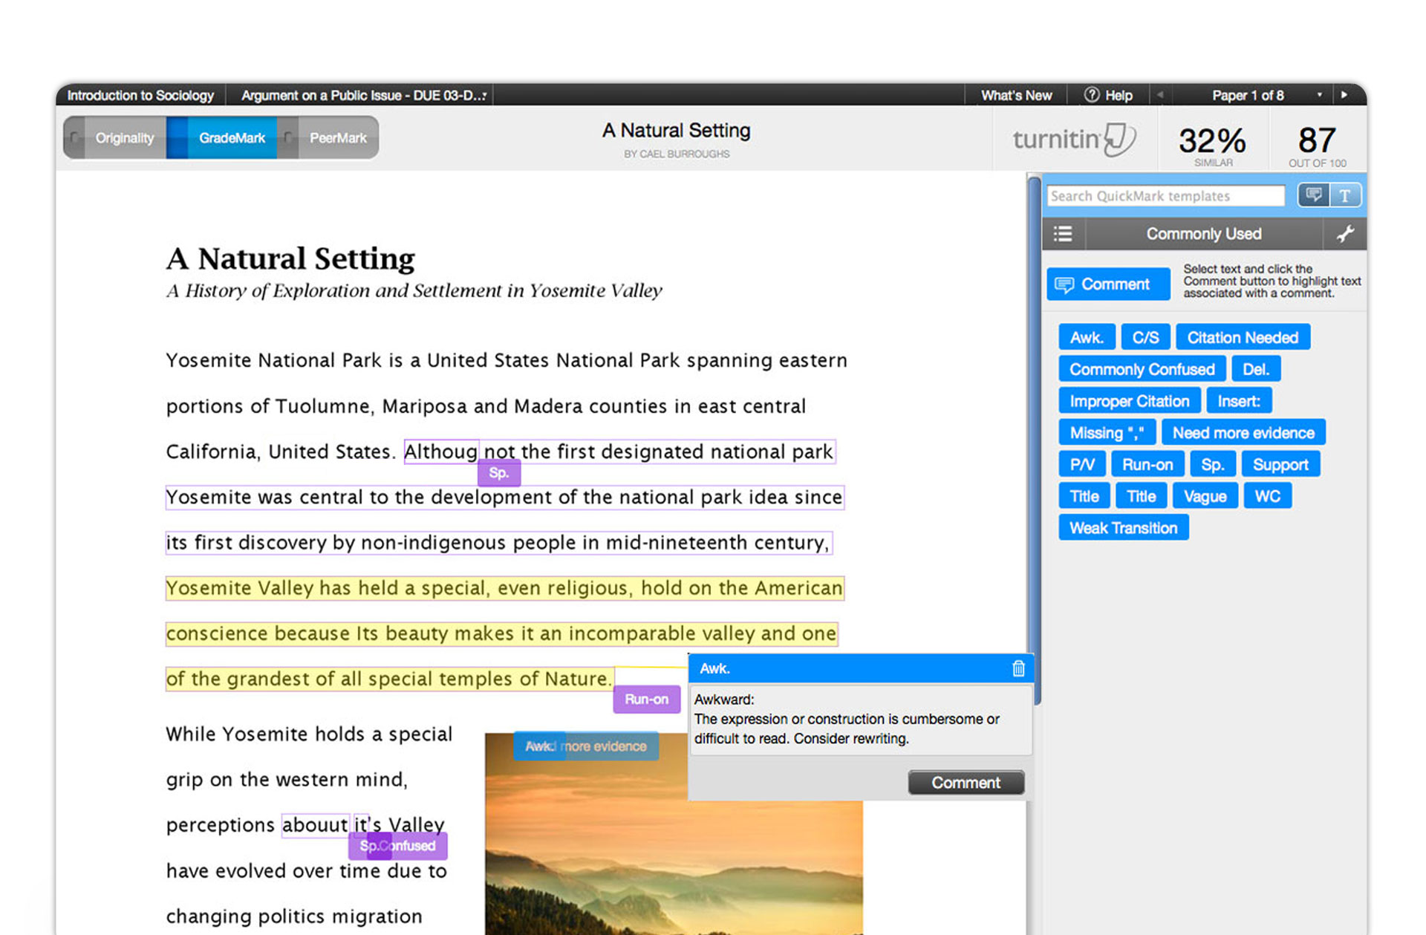
Grading & Feedback
Notes:
Here is the instructor’s view of GradeMark, our online marking & grading tool that includes the ETS grammar engine.
On the right is the pallet of blue QuickMarks, some of which have been dropped onto the paper. You can see the ‘Awk’ mark opened on the paper with the explanation of ‘Awkward.’
The purple marks are from ETS and you can see that it’s identifying some of the spelling, style and mechanics issues.
From here, it’s very easy for instructors to leave feedback using:
Pre-set QuickMarks or Custom QuickMarks created ‘on the fly’ & stored in convenient Libraries for future access
- Voice Comments
Rubrics, and
- General Comments
…and then transfer the student’s grade into a Gradebook within Turnitin.
Additionally, the Originality Report can be overlaid onto this GradeMark view so the instructor can comment on the content matches to teach proper citation methods and see a more comprehensive view of all the feedback on the paper.
So it’s very easy for instructors to save grading time while increasing the quality of their feedback. We expect that in a few years, most papers will be graded using online tools like GradeMark.

Slide 12
iPad

Slide 13

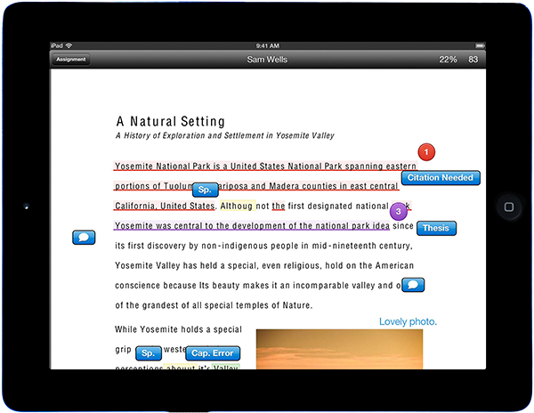
Grade Anywhere with Turnitin for iPad
iPad is a trademark of Apple Inc.

Slide 14
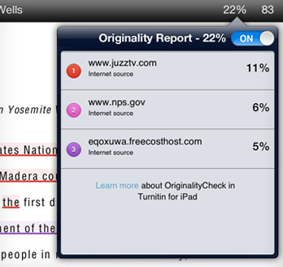
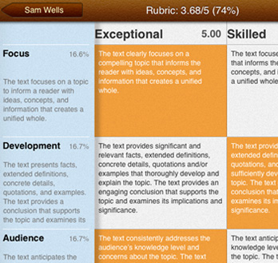
Turnitin ipad
Feedback at Your Fingertips
Originality Report
QuickMark comments
Voice comments
Custom text comments
Highlights
Strike through
Speech to text
Interactive Rubric Grading
Convey clear expectations and grade faster with interactive rubrics. Simply tap the rubric criteria, and the grade is automatically calculated. No calculators, no spreadsheets.
iPad is a trademark of Apple Inc.

Slide 15
EFFECTIVENESS
Notes:
I’d like to take some time to discuss the efficacy of Turnitin and then discuss some of the strategies for best using Turnitin.

Slide 16
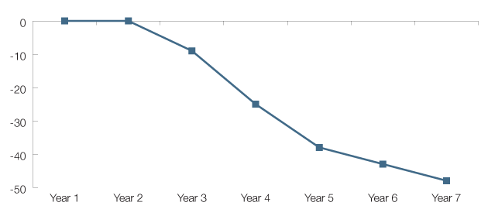
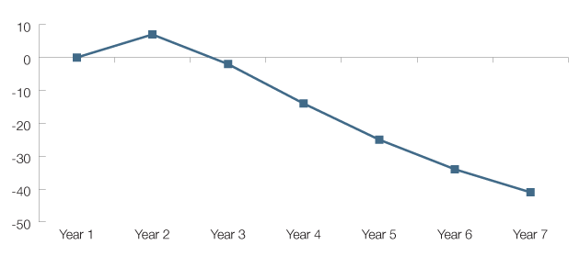
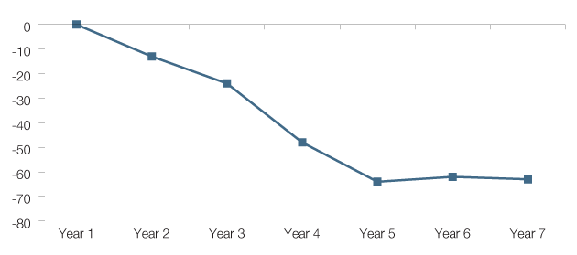
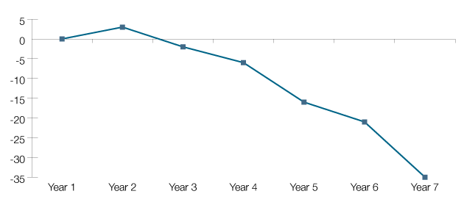
Evidence of Effectiveness - U.S. Customers
Higher Education:
48% Decrease in Unoriginal Content*
4-Year Institutions:
41% Decrease in Unoriginal Content*
*33,860,285 submissions from 917 higher education accounts over 7 years.
*25,913,970 submissions from 674 4-Year Institution accounts over 7 years.
2-Year Institutions:
63% Decrease in Unoriginal Content*
Secondary Schools:
35% Decrease in Unoriginal Content*
*7,946,315 submissions from 243 2-Year Institution accounts over 7 years.
*35,572,378 submissions from 2,862 Secondary School accounts over 7 years.
Notes:
Turnitin analyzed our entire United States customer base to understand what impact the use of Turnitin had on unoriginal content in their institutions. We looked at the level of unoriginal papers (50-100% unoriginal) as a percentage of total submissions in each account and then compared them against the % of unoriginal papers in the most recent year of use (2012). What you can see based on the charts, which show the aggregate totals, is a significant drop in unoriginality when institutions use Turnitin.

Slide 17
ACADEMIC
INTEGRITY
Notes:
Many of the schools and districts that adopt Turnitin, implement it with the intent of using the service as a way to support their institutional academic integrity policies.

Slide 18
Sample Academic Integrity Statement
Additional copy to include:
“In support of Academic Integrity at <your institution>, Turnitin will be used to review the papers that you submit in this class. Turnitin does not determine whether plagiarism has taken place or not. Turnitin will also not be used as a punitive tool or measure. The teacher of this class will use the reports that Turnitin generates as a basis for the thorough evaluation of the authenticity and originality of your work and the work of your classmates.”
Training & Professional Development
Notes:
As a way to inform students about Turnitin’s use at the class level and its use to support your academic integrity policy, I’d suggest that instructors include specific mention of the institution’s stance on plagiarism in their syllabi. I would encourage you to add more detail to this. In our experience working with institutions—it’s better to be more explicit in what might constitute plagiarism. Here is some additional copy on the use of Turnitin that I also encourage you to include…
This is sample copy that you are free to use. Adjust the copy as you see fit. From the standpoint of best practices in using Turnitin, institutions that have their instructors include information about Turnitin in their syllabi report seeing significant results in ensuring originality in student work.
NEXT SLIDE: Strategies

Slide 19
STRATEGIES
Notes:
So what are some of the strategies for successful Turnitin usage?

Slide 20
Originality Reports: Effective Use
Turnitin identifies “matched content”
Instructors determine whether matches constitute plagiarism
Color coding of percentage scores do NOT signify plagiarism
Exclude quoted material and bibliography to refine results
Training & Professional Development
Notes:
With Turnitin Originality Reports, it’s important to remember that Turnitin does not detect plagiarism.
What the service does is to surface and identify “matched content.”
It’s ultimately up to the instructor to determine whether matches constitute plagiarism.
The color coding that accompanies percentage scores (as well as the scores themselves) do NOT signify the amount or degree of plagiarism that appears in a specific paper.
Turnitin will also identify properly quoted and bibliographic information. Depending on the course or assignment type, you might consider excluding quoted and bibliographic material from the search.
NEXT SLIDE: Assignment setup

Slide 21
Assignment Preparation and Setup
Peer review theses
Assign annotated bibliographies
Use multiple paper drafts to provide students with the opportunity to develop their writing over the span of an assignment
Training & Professional Development
Notes:
In terms of assignment preparation and setup, we’ve found the following to be especially effective in helping to support students in doing original work:
Consider assigning peer review of theses, so that students have the opportunity to vet their arguments prior to embarking on the writing assignment. This gives students the opportunity to receive early feedback on their ideas and to take early ownership of their work (and understand audience at the same time).
A recent Pew research report on “how students do research in the digital age” underscores the challenges students face when doing research. Though poor research skills is not a precondition for plagiarism. Poor research skills can be a contributing factor. Consider assigning annotated bibliographies as part of the overall paper assignment.
For instructors that teach writing, consider using a multiple draft approach (with instructors providing feedback along the way) so that students have the opportunity to develop their writing.
NEXT SLIDE: Plagiarism Spectrum

Slide 22
PLAGIARISM
SPECTRUM
Notes:
We’re going to switch gears here and talk about some of the “research” that we do here at Turnitin.

Slide 23
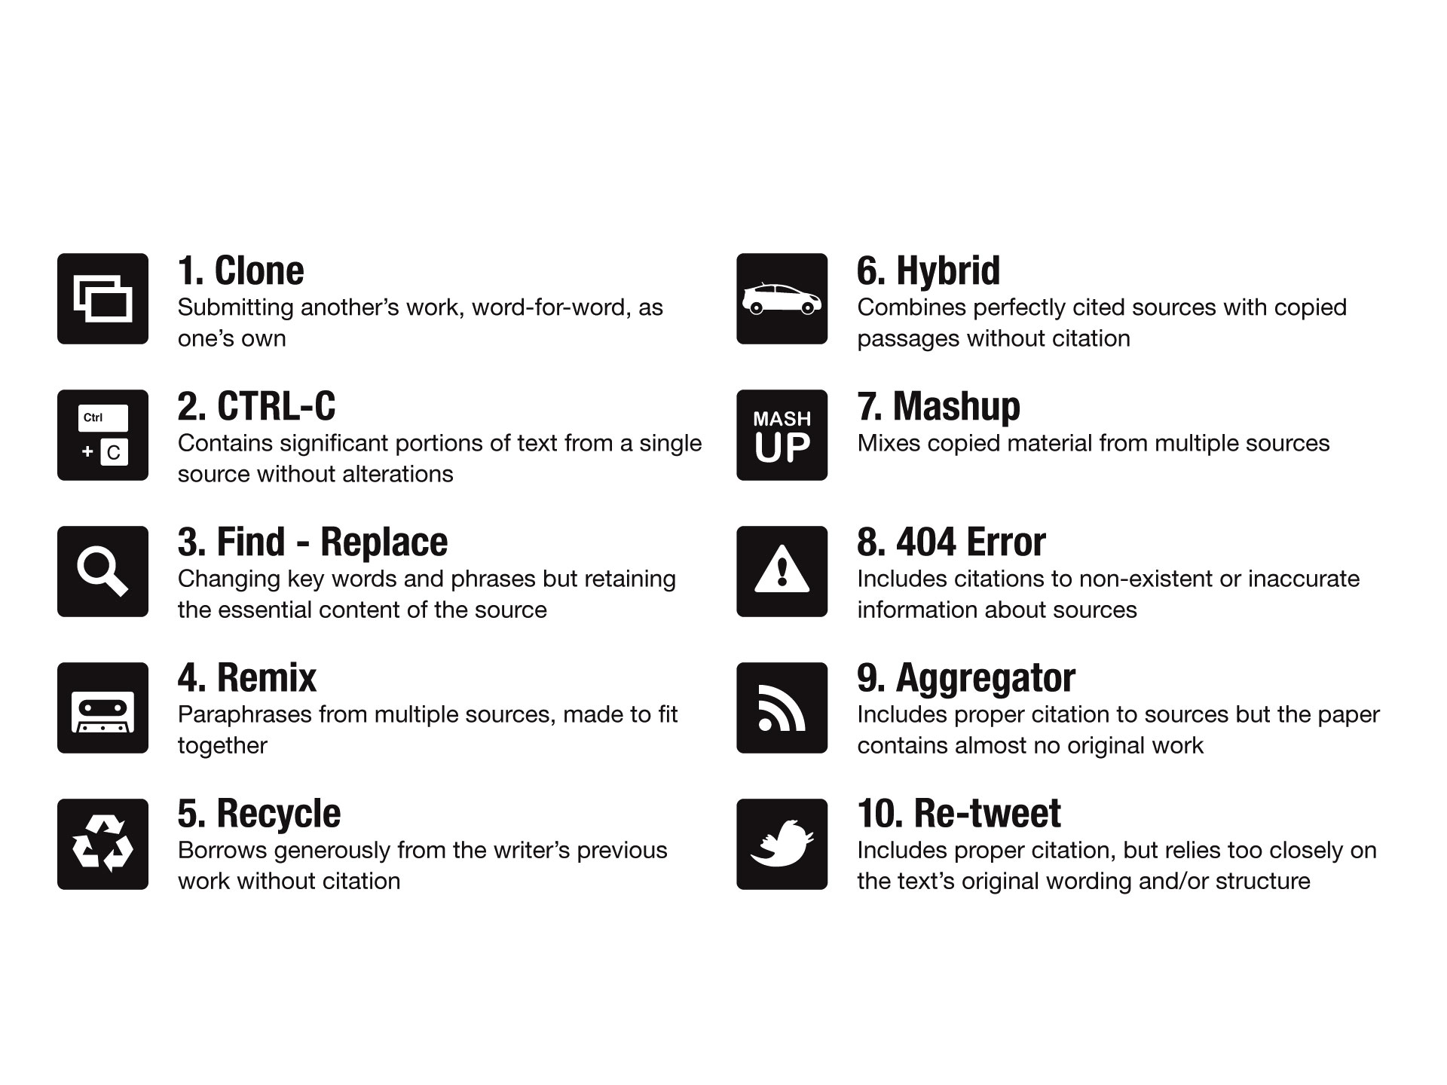
Tagging the 10 Types of Plagiarism
Notes:
The Plagiarism Spectrum is a guide that Turnitin developed to help educators, students, academics, and writers recognize the various forms of plagiarism. This spectrum moves plagiarism beyond the black-and-white definition of “literary theft” to one that captures the nuances of how plagiarism can take form.
The Spectrum is an outcome of the study of thousands of plagiarized papers, providing examples of 10 distinct types of plagiarism that comprise the vast majority of unoriginal work in student papers. These types are defined across a spectrum of intent and have been given titles to reflect both the influence of the Web on plagiarism and to help make the definitions more meaningful to the generation of students who are “digital natives.”
As part of this study (April 2012), Turnitin surveyed both higher and secondary education instructors to take a measure of how prevalent and problematic these instances of plagiarism are among their students. The Plagiarism Spectrum ranks the types of plagiarism by intent and then provides data on the prevalence and problematic nature of type based on the feedback from 879 survey respondents.
On this slide, you can see the 10 types listed along with their definitions. The next set of slides show examples of each type. We’ll start with the most prevalent and egregious type of plagiarism, the “Clone.”

Slide 24
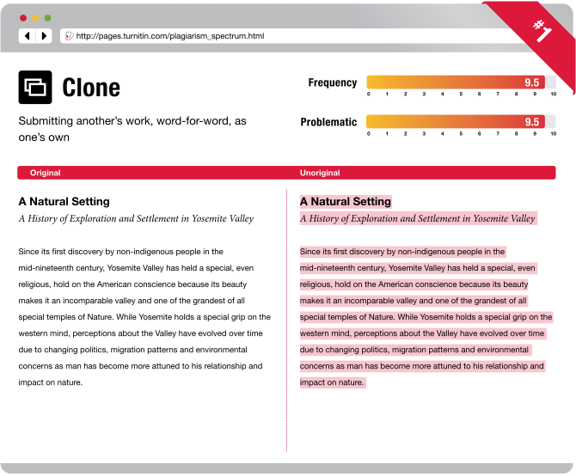
Notes:
With this set of visual examples, we endeavor to show what this type of plagiarism might look like. At the top is the definition of the type. Below that, you’ll see the “Original” text and next to it the “Unoriginal” version with the questionable copy highlighted. In the upper-right hand corner, you’ll see the “Frequency” with which our survey respondents reported seeing this type of plagiarism, along with how “Problematic” they thought this type of plagiarism is. The Clone came in as the most frequent and problematic of all 10 types that our survey respondents reviewed.

Slide 25
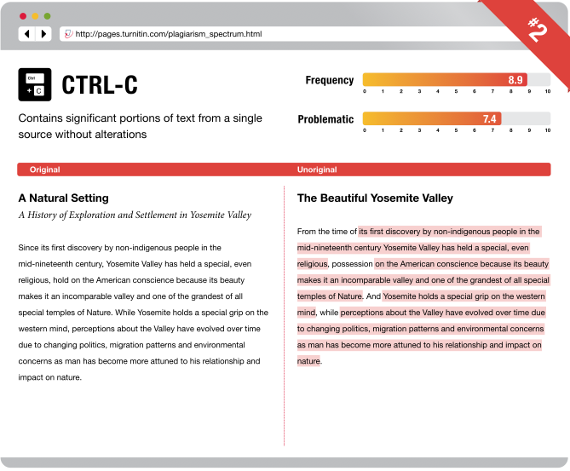
Notes:
Next, we have “CTRL-C” also known as “copy-and-paste.” Here, you can see that not ALL of the text has been copied. Frequency for this type is also high as well as the problematic score. The “2” in the very upper right is the rank of this type of plagiarism in terms of its egregiousness or intent.

Slide 26
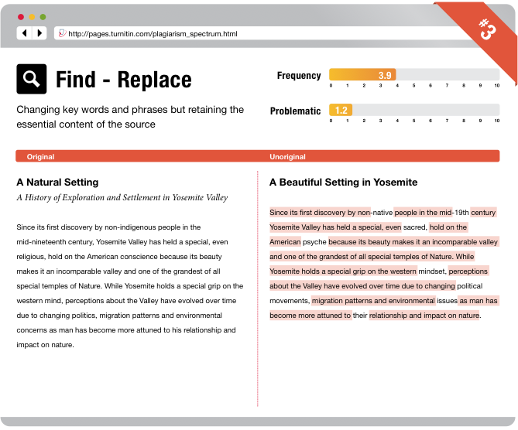
Notes:
“Find-Replace” yields a moth-ridden version of the original. Note the frequency and problematic scores.

Slide 27
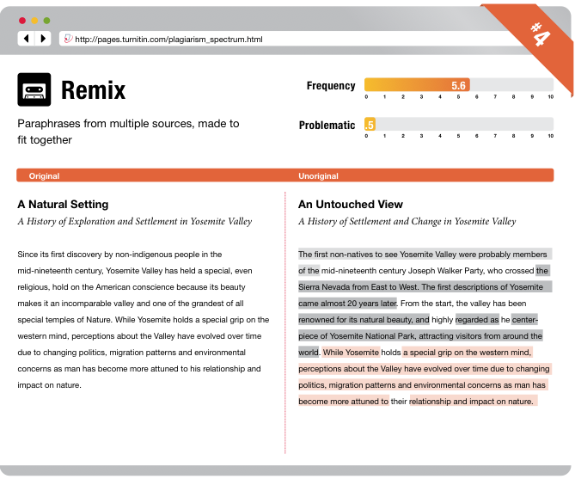
Notes:
“Remix” is a paper that consists of paraphrasing of content from multiple sources. Note the “patchwork” text that emerges from this type of plagiarism. This is low on the “Problematic” front, because instructors typically see “patchwork” writing as a step that emerging writers take when trying to write for a new discipline or about a wholly-new subject matter.

Slide 28
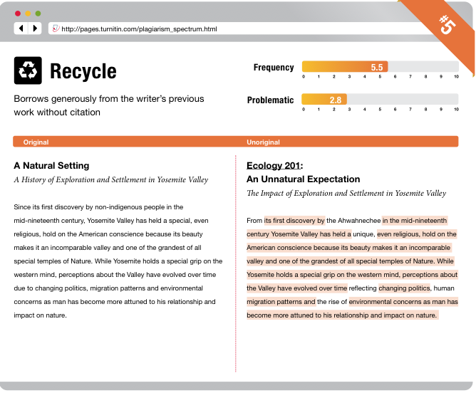
Notes:
The “Recycle” is the paper that was written for one class, but then reappears for a new assignment in a new class. Look at the title changes and the change in the course. Students have a tendency to recycle their own work (hence the higher problematic score). As a general rule of thumb, we suggest that instructors who do not wish to see recycled work include a statement in their syllabi that indicates that only “original work, written for this class is acceptable to fulfill assignment and course requirements.”

Slide 29
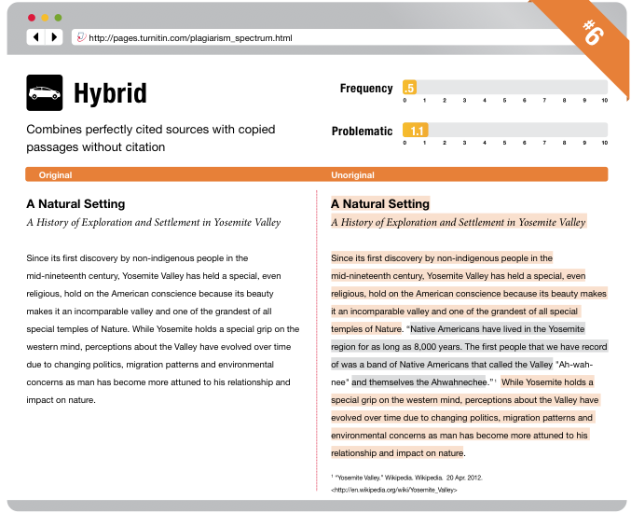
Notes:
The “Hybrid” combines perfectly cited sources and copied passages.

Slide 30
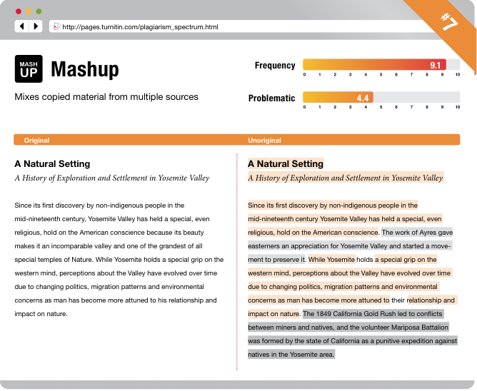
Notes:
The “Mashup” is NOT paraphrasing—this is just the act of copying material from a number of sources and putting them together to make a paper. In other words, this is an example of how NOT to do a research paper.

Slide 31
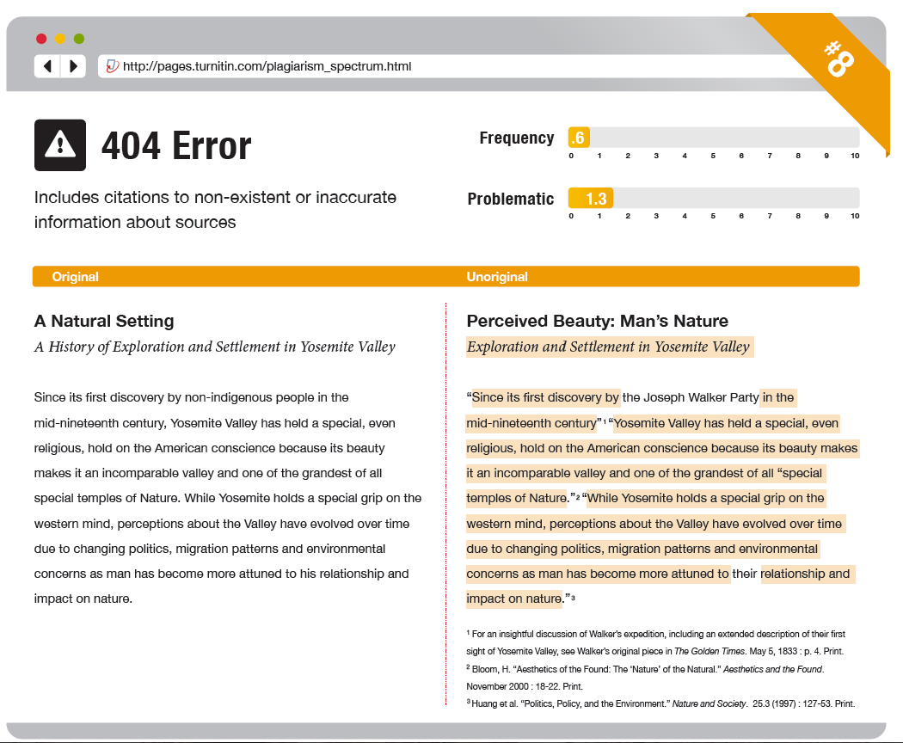
Notes:
The “404 Error” happens when students include false or incomplete citations.

Slide 32
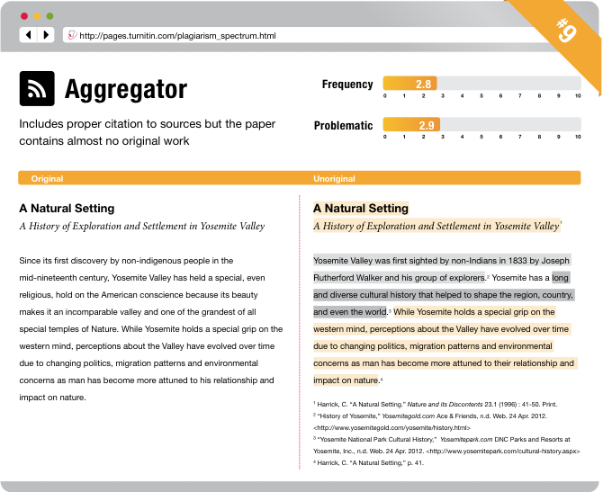
Notes:
At number 9, we have the “Aggregator,” which is the “Mashup” but with proper citation. An example of what some students consider a “research” paper.

Slide 33
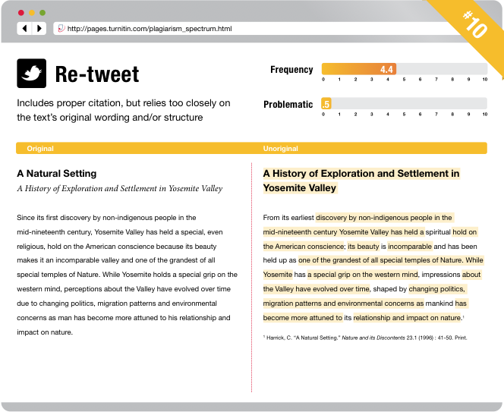
Notes:
Last, we have the “Re-tweet,” which includes proper citation, but relies much too closely to the original.
As a strategy, we suggest that instructors share the Spectrum with their students. If class time allows, instructors might also consider having students discuss the types.

Slide 34
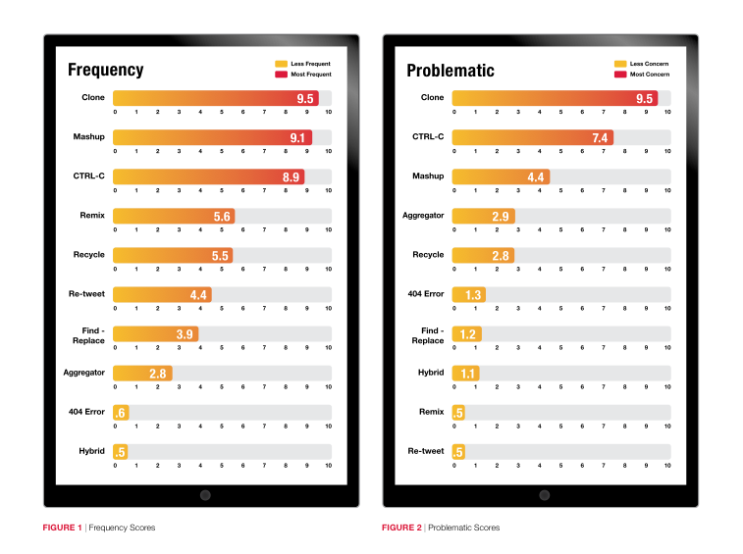
Notes:
This slide is to show the Frequency and Problematic rankings of the types.

Slide 35
More Information
View Infographic:
http://bit.ly/plagiarismspectrum
Read White Paper:
http://bit.ly/plagiarismspectrumwp
Plagiarism.org: http://www.plagiarism.org
Training & Professional Development

Slide 36
STUDENT SOURCES
Notes:
We’re going to switch gears here and talk about some of the “research” that we do here at Turnitin.

Slide 37
How do students research in the digital age?
“The internet has changed the very meaning of research”*
Students value immediacy over quality in online research
Over reliance on the “wisdom of the crowd”
*Pew Internet and American Life Project, How Teens Do Research in the Digital World, 2012
Training & Professional Development
Notes:
According to a recent Pew study (Nov. 2012), “How Teens Do Research in the Digital World,”-- “the internet has changed…” The Pew study came out as we were finishing up our annual matched content analysis—a review of the matches between student papers and online content. The Pew study really prompted us to consider what we could do to take the matched content data that we had gathered—which really underscored how students were doing research online and make it more actionable for instructors.

Slide 38
About this study
Time frame: July 2011 to June 2012
38.3 million papers submitted to Turnitin in the U.S.
  Secondary Education: 9,931,758 papers
  Higher Education: 28,404,572 papers
156 million content matches
Training & Professional Development
Notes:
Since 2010, Turnitin has conducted an annual analysis of content matches between student submitted papers and to content found online. These analysis, as a whole, have highlighted the challenge that students find in vetting online sources for their written work. For the latest review, we looked at 38 million student papers and isolated 156 million content matches to online content.

Slide 39
Turnitin Content Database
35+ billion pages of indexed web content
400+ million student papers plus 300,000 new papers daily
130+ million articles from periodicals, journals, and other content databases
Training & Professional Development
Notes:
Specifically, this meant focusing on the over 30 billion pages of indexed web content in our database. That said, student papers submitted into the service can be also compared against—and often is—the 300 million student papers in the paper repository as well as 130 million journal articles (largely STEM).

Slide 40
Matched Content Categories
Category | Definition
Social Networking & Content Sharing | Sites that rely on user-generated content rather than professionally-published content.
Homework & Academic | Academic, educational and homework help sites that offer a range of content to educate students.
News & Portals | This category consists of professionally-published content.
Paper Mills & Cheat Sites | Sites that promote the sale or sharing of written work.
Encyclopedias | Reference and summary sites
Shopping | Sites that offer reviews and sell products.
Training & Professional Development
Notes:
As part of the annual analysis, we’ve traditionally bucketed these matches into 6 broad categories:
Social Networking and Content Sharing—sites like Yahoo! Answers would fall into this category
Homework and Academic—sites like coursehero.com or enotes.com would fall into this categroy
News and Portals—sites like the NYTimes
Paper Mills and Cheat Sites—sites like OPPapers.com or schoolsucks.com, and my favorite—unemployedprofessors.com
Encyclopedias—wikipedia would fall into this category
And yes, surprisingly, Shopping sites—amazon.com or barnesandnoble.com (where students appear to mine book reviews for content).
In terms of percentage of matches, by category, let’s take a look at how they break out be category as well as educational level

Slide 41
Secondary & Higher Education
(July 2011 – Jun 2012)
Category | Secondary Ed Matches | Higher Ed Matches
Homework & Academic | 33% | 33%
Social Networking & Content Sharing | 28% | 23%
Paper Mills & Cheat Sites | 18% | 19%
Encyclopedias | 11% | 14%
News & Portals | 6% | 10%
Shopping | 4% | 1%
Total 100% | 100% | 100%
Training & Professional Development
Notes:
What’s notable is the significant number of sources that match to Homework and Academic and Social Networking and Content Sharing sites. It makes sense that the homework and academic sites would come up at a high proportion. In light of students’ propensity to share, social networking and content sharing comes as little surprise. Paper mills and cheat sites come in at nearly 20%--which is troubling. And, though encyclopedias may not appear to take as significant a share, wikipedia does come in as the most matched site in our study.
I also want to quickly point out the higher proportion of secondary matches in the shopping category.
Now, let’s make this more interesting by taking a look at some of the top sites that were used

Slide 42
Top 10 Sources: Secondary Ed
Top Sites 2011-2012 | Number of Matches | % | Category | Rank in 2010-2011
wikipedia.org | 3,801,022 | 8% | Encyclopedias | 1
answers.yahoo.com | 2,929,041 | 7% | Social | 2
enotes.com | 1,440,129 | 3% | Homework | 4
answers.com | 1,248,710 | 3% | Social | 3
oppapers.com | 1,245,097 | 3% | Paper Mills | 7
scribd.com | 1,144,111 | 3% | Social | 6
slideshare.net | 953,619 | 2% | Social | 5
essaymania.com | 932,709 | 2% | Paper Mills | 8
shmoop.com | 880,635 | 2% | Homework | 11
medlibrary.org | 846,165 | 2% | Homework | 12
Training & Professional Development
Notes:
Here’s a quick look at the top 10 sources—as you can readily see Wikipedia ranks high—capturing nearly 8% of matches. As you can see its rank has not changed from the previous year. The same can be said both about % of matches as well as rank for answers.yahoo.com. Oppapers.com—a paper or essay mill moves up the ranks. Also note the significant presence of social networking and content sharing sites.
What do you see missing category-wise?
How does this change when we look at the higher ed matches:

Slide 43
Top 10 Sources: Higher Ed
Top Sites 2011-2012 | Number of Matches | % | Category | Rank in 2010-2011
wikipedia.org | 12,164,091 | 11% | Encyclopedias | 1
oppapers.com | 4,492,283 | 4% | Paper Mills | 5
slideshare.net | 4,051,018 | 4% | Social | 3
coursehero.com | 3,966,939 | 4% | Homework | 6
scribd.com | 3,461,809 | 3% | Social | 7
answers.yahoo.com | 3,188,527 | 3% | Social | 2
answers.com | 3,186,959 | 3% | Social | 4
medlibrary.org | 3,123,904 | 3% | Homework | 8
bignerds.com | 2,633,248 | 2% | Paper Mills | 16
papercamp.com | 2,454,094 | 2% | Paper Mills | 14
Training & Professional Development
Notes:
Again, we see Wikipedia ranked at the top at 11% Look at the dramatic difference between its proportion of matches to its nearest contender, oppapers.com (4%).—a paper mill is number 2. Also note how minor the difference there is between the sites used by secondary and higher ed students.
Again, what do you see missing?

Slide 44
Findings
Students struggle to recognize bias in sources
Students are not always <insert word here> in evaluating sources for quality and appropriateness
Research is synonymous with “search”
Training & Professional Development
Notes:
What these finding present in broad strokes, I’d argue, is that students struggle to recognize bias in sources—not just bias, really, but intent. Also, students are not always “careful” (insert your word here is intentional) or “skilled,” “practiced.” Ultimately, what the results underscore is something that is often heard about student research online, which is namely that it is “search” and not “research.”
Let’s switch gears here and talk about the follow-up to the match content study, which is the Source Educational Evaluation Rubric.

Slide 45
SOURCE EDUCATIONAL EVALUATION RUBRIC (SEER)

Slide 46
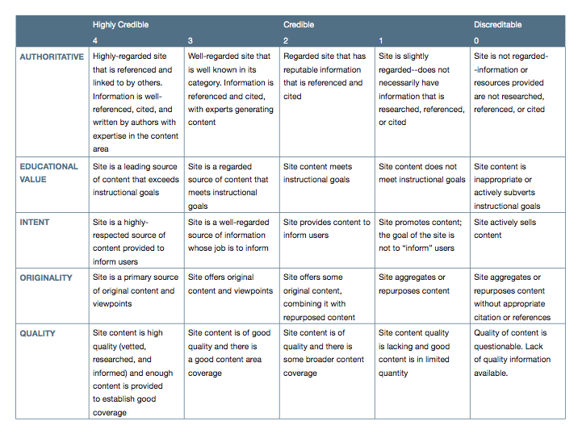
Source Educational Evaluation Rubric (SEER)
Notes:
Here’s a screenshot of the rubric. The intent of this rubric is to help foster student critical awareness of the quality of the sources that they frequently use. As you can see here, the rubric itself is built upon a set of 5 criteria. And, in keeping with the intended use within the academic context, each criterion is rated on a 4.0 scale—from highly credible to discreditable.

Slide 47
SEER Criteria
Authority: Is the site well regarded, cited, and written by experts in the field?
Educational Value: Does the site content help advance educational goals?
Intent: Is the site a well-respected source of content intended to inform users?
Originality: Is the site a source of original content and viewpoints?
Quality: Is the site highly vetted with good coverage of the topical area?
Training & Professional Development
Notes:
Let’s take a closer look at the criterion. I should mention that the rubric is under creative commons license and may be modified for use with your specific classes as you see fit. I have received some feedback from secondary teachers who’ve mentioned that the language used in the rubric may be a bit challenging for some of their students. Again, I encourage you to use the rubric—and use it as a suggested starting point for developing your own. The goal here with the rubric is to open up discussion with students and build their awareness.
Let’s turn to the scoring…

Slide 48
SEER Scoring
4.0 – 3.0: “highly credible, quality sources”
3.0 – 2.0: “credible sources”
2.0 – 1.0: “questionable sources”
1.0 – 0.0: “unacceptable or inappropriate sources”
Training & Professional Development
Notes:
We’ve anchored the numerical score with qualitative comments on credibility.
Let’s take a look first at a sample rating and then we’ll proceed to review some of the ratings that were proposed by a panel of educators who helped to rate 200 of the top sites.

Slide 49
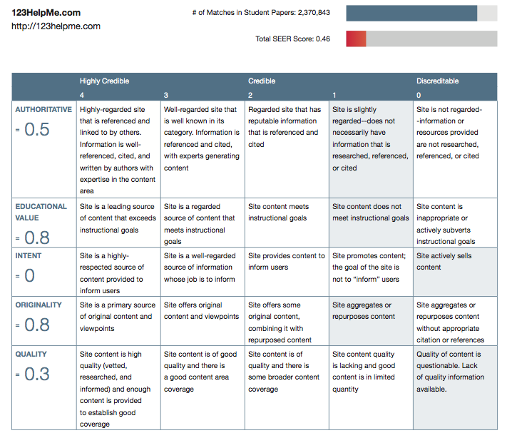
Discreditable Source

Slide 50
Wikipedia’s SEER Score
Secondary Ed Panelists | 2.55 / 4.0
Higher Ed Panelists | 1.07 / 4.0
Training & Professional Development
Notes:
From one secondary ed panelist: “Despite a bad rep from traditional media specialist types, still can be a great first stop in legitimate research”
From our HE panelist: “This site is GREAT for idea generation, and that's it!”

Slide 51
SEER Average Ratings by Category
Category | Average Rating
Social Networking & Content Sharing | 1.59 / 4.0
Homework & Academic | 2.40 / 4.0
News & Portals | 2.05 / 4.0
Paper Mills & Cheat Sites | 0.59 / 4.0
Encyclopedias | 2.02 / 4.0
Shopping | 1.65 / 4.0
Average Across Categories | 1.79 / 4.0
Training & Professional Development

Slide 52
Implications
Assessment not assumptions
Textual literacy skills
Hands-on practice
Training & Professional Development
Notes:
“hands on practice”—put the rubric to use. Give it a try with students, get them to weigh in and discuss the criteria.
“assessment not assumptions”—the implication here is that we need to not assume what they know about sources, but actually assess them.
How would you do this with your students?

Slide 53
Resources
SEER Interactive Rubric
http://pages.turnitin.com/seer_rubric.html
SEER White Paper
http://pages.turnitin.com/evaluating_sources.html
Ratings for Top Student Sources
http://www.turnitin.com/assets/en_us/media/seer/he/all.php#.UaZ1NiuG1Z8
Training & Professional Development

Slide 54
ADDITIONAL RESOURCES
Notes:
Let me turn to some additional resources that are available to you. Then, we’ll move to take any additional questions.

Slide 55
Additional Resources
Live Expert Training
Tutorial Videoshttp://www.turnitin.com/en_us/training/instructor-training
White papers and Webcastshttp://www.turnitin.com/en_us/resources/white-papers http://www.turnitin.com/en_us/resources/webcasts
Help Center http://www.turnitin.com/en_us/support/help-center
Training & Professional Development

