Slide 1

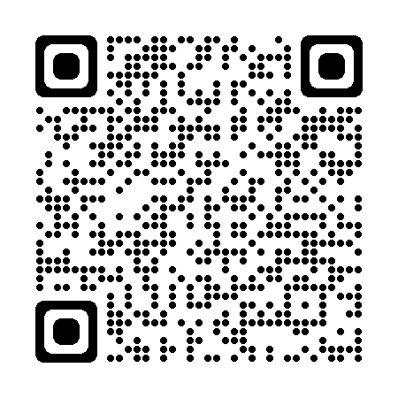

Academic Technology Overview
Academic Technology Overview
Kurt Villcheck,
IT Specialist/Simulation Assistant
IT@pson.edu

Slide 2
TOPICS
Academic Technology Policies
Moodle
  User Login
  Editing Your Profile.
  Setting Preferences
  Entering your course page
  Viewing Course content
PSON IT Support Request
PSON Moodle Mobile
PSON Gmail
ExamSoft
Campus Portal

Slide 3
Academic Technology Policies overview
Levels of Support
  Program required Applications – Full support
    Moodle, Gmail, Empower, etc.
  School owned equipment – Full support
  Personal Education Equipment
    Limited to Troubleshooting
  Third Party Applications
    Limited to Troubleshooting
Google Drive
  Avoid uploading Personal Sensitive Information
  Alumni e-mail for up to a year
Phishing
  Responsible for your own activity
  Don’t open e-mails from Unknown Senders
  Do not disclose personal information to suspicious parties
  Report suspicious e-mails to IT@pson.edu

Slide 4

What is Moodle?
Moodle is an open source learning management system used by many schools and universities worldwide. It allows educators to create a secure personalized learning environment rich in all forms of digital content.

Slide 5
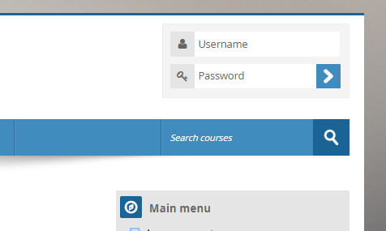
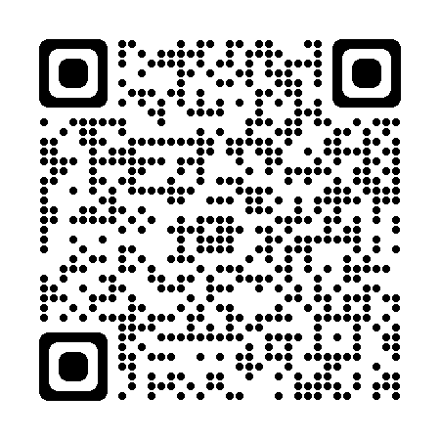
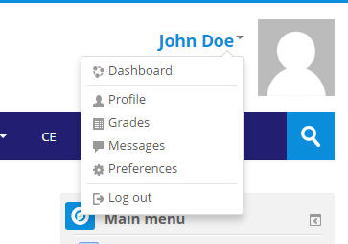
Moodle Login
Editing Your Profile
When you go to the Moodle page, at pson.moonami.com, you will login to your account on the upper right hand corner of the page.
Scan for Moodle
Username: Your first and last name (all lowercase)
Example: johndoe
Password: Ps185973@ (Cap P)
It will make you change password at login.
Click on your name, or the triangle to the right of your name to pull up the dropdown menu as shown below. Choose Preferences.

Slide 6
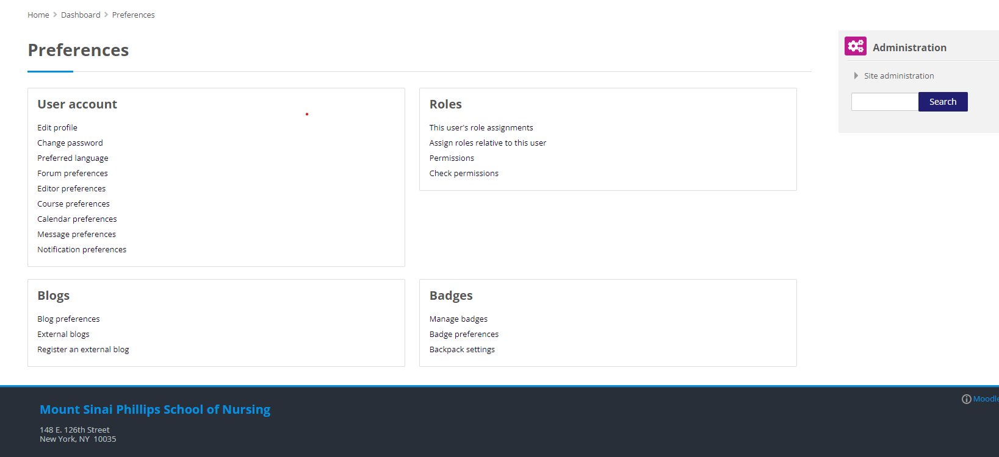
3. Setting Preferences
From your Preferences menu choose Edit Profile to update your information such as your email address, interests, or upload your photo. Choose Change password to update your password.

Slide 7
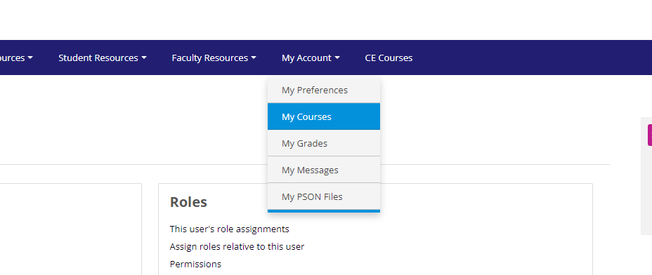
4. Entering your course pages.
You can access your course pages by clicking on my account and my courses from the Moodle navigation menu.

Slide 8
5. Viewing Course content
The content on the course pages are in weekly format. The top section is reserved for general course documents, such as learning packets and course outlines.
To open content, click on the file name. You will need to have the application associated with the file to view it. Note: If you do not see the file loading it may be minimized. The icon next to the file shows you what type of file it is.
On the top right you have Latest news which will be news updates from your instructors. The calendar displays upcoming courses and events. The calendar is not used for every course, so it will depend on if your instructor uses it.

Slide 9
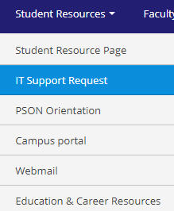

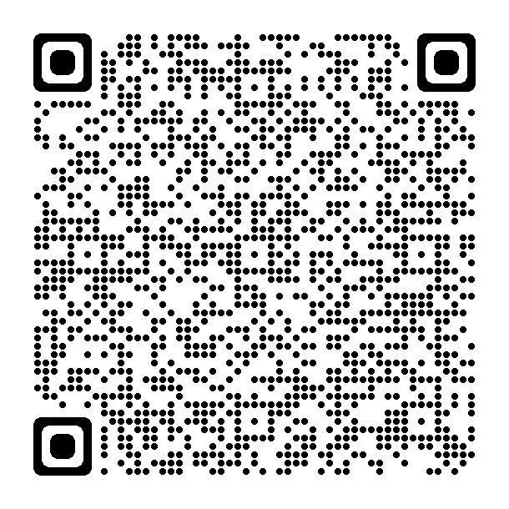
6. IT Support Request
To request PSON IT support from Moodle click on Student Resources/ IT Support Request.
2. You can also submit a Support request anywhere by scanning the QR code with your mobile phones camera.

Slide 10
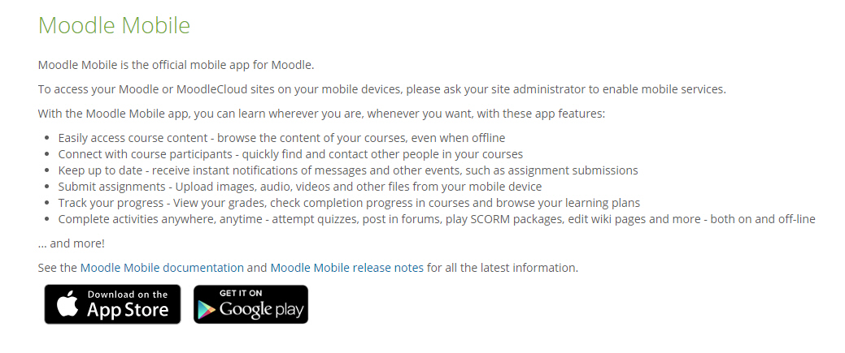
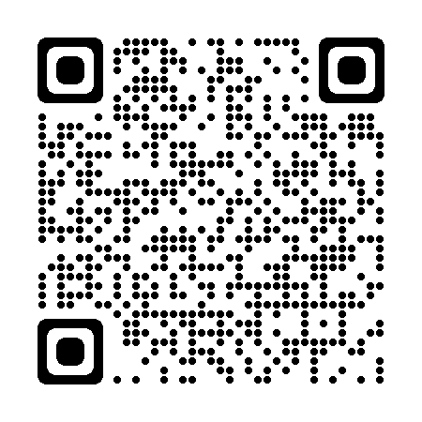
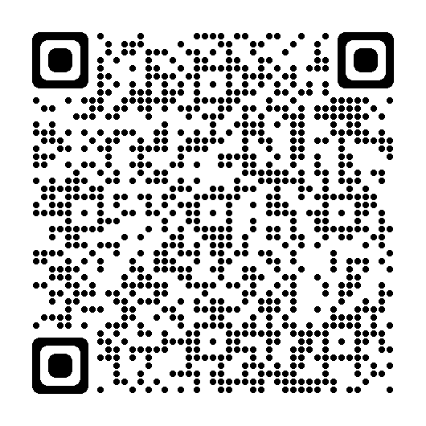
Moodle Mobile
To use Moodle on your mobile phone, you will first need to download the app from the app store. You can find it by searching for Moodle Mobile on Apple app store, the Google Play Store, or scan QR code below.
When setting up the app it will ask for the url. Type in pson.moonami.com
Scan for Apple
Scan for Android

Slide 11
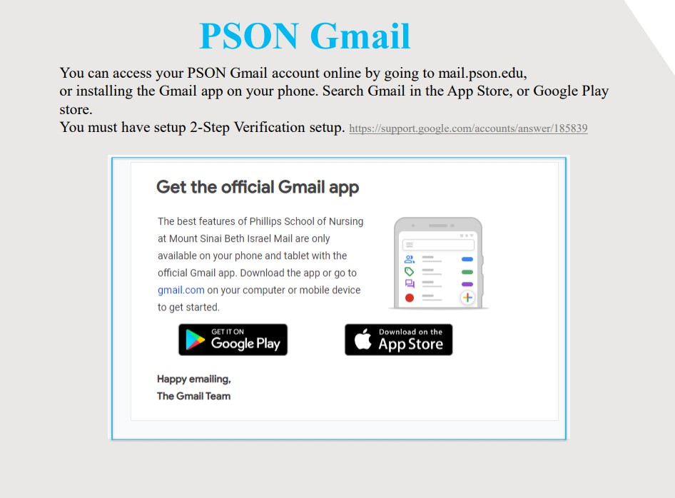

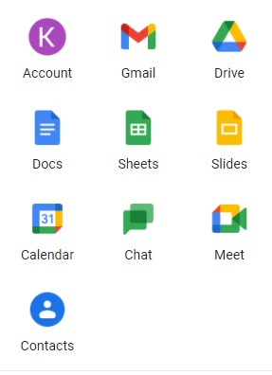

Slide 12

ExamSoft
What is ExamSoft?
ExamSoft provides a secure testing environment. It Prevents and deters Academic Dishonesty, and allows instructors to easily create, grade, and analyze exams.
Features
Works offline – internet access only required to download and upload the exam
Ability to lock down the exam taker’s device
Ideal for both in-person and remote learning settings
Allows Secure Exam Review options
See Moodle Student Resource page for Installation guide and more information.

Slide 13
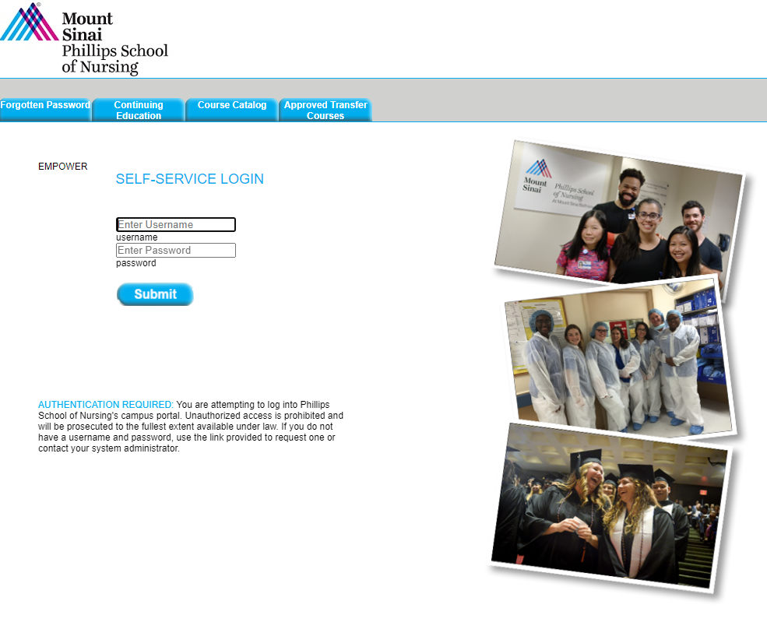
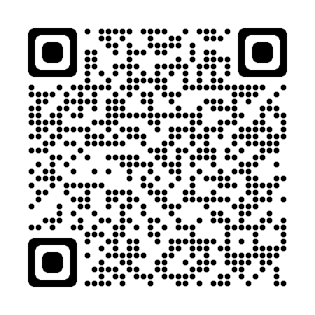
Campus Portal
https://pson.empower-xl.com/fusebox.cfm
Scan for Campus Portal

Slide 14


Academic Technology Department
Thank You!
Academic Technology Team
Report scams to: IT@pson.edu

